Slide 1
DIY: Usability Testing for Business Analysts
Pittsburgh IIBA, January 9, 2017, Carol Smith, @carologic
Portions of this presentation were created with Thyra Rauch

Slide 2
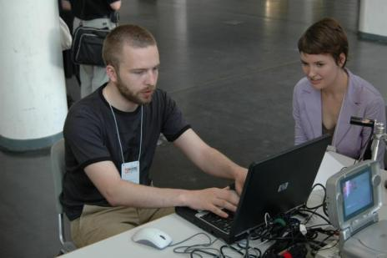
Usability Testing
http://creativecommons.org/licenses/by-sa/2.0/
http://www.flickr.com/photos/raphaelquinet/513351385/sizes/l/in/photostream/
http://www.flickr.com/photos/raphaelquinet/

Slide 3
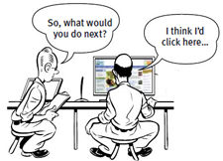
Usability Tests
Measure the UI’s ability to support users in achieving specific goals
Real users, doing real tasks
Prototypes or live products
Observed, not guided
Image from Steve Krug’s “Rocket Surgery Made Easy“

Slide 4
It is not…
Testing the participants abilities
Quality testing
Full accessibility testing
System testing
Acceptance testing

Slide 5
Why Test?
You are not your user
May miss details; too close to design
Unforeseen requirements
Validate understanding of tasks and context
Improved UX = more satisfied users
Less training needed
Fewer services calls
Notes:
Tell story about SSA prototype of button being located at top level because of things recorded during contextual inquiry, but then discovering during testing that when they actually used the system to do something, that step was not a top level step, it only occurred IF some other event had occurred – so presenting it at the top level was confusing. It was in the wrong place.

Slide 6
Test early to avoid mistakes
http://www.flickr.com/photos/dwulff/12256075/sizes/m/in/photostream/
http://www.flickr.com/photos/dwulff/

Slide 7
Getting Started

Slide 8
Design the Test
Set a goal
Type of participants
Tasks for participants to attempt
Share with team (if applicable)
Keep concise
Notes:
8
In this slide we are listing the end to end set of high level steps once a decision has been made to do usability testing, up to conducting the test.
These items need a full 1-2 day tutorial unto themselves.

Slide 9
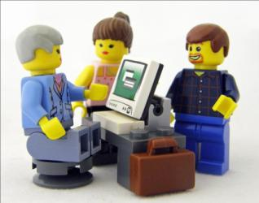
Create Tasks
Representative of typical tasks
Describe what, not how
“You want to buy a shirt for your father. Find a man’s blue dress shirt for under $40.”
“As a systems administrator for your company, you want to install, configure, and test the xyz application.”
Avoid leading or matching UI wording
Notes:
Even though creating test scenarios is part of designing the usability test, the reason we have highlighted this step is because this is very similar to some of the facilitating techniques we’ll be talking about later. There is a commonality of good guidelines in interacting with users, that is applicable to both written and verbal interaction.
(show example of end user prototype)
(show one I did for Yahoo! Edition)
I tend to work with fairly explicit task scenarios early on, or with mockups, and then, as things get more resolved, I move to very open-ended scenarios that allow users to approach the task in their own way.
It’s also important to ask your users if the task is something they’d actually do – a reality check. I usually have to revise my scenarios somewhat after the initial pilot test.
Bad examples: “Use the markup tool to mark up your document”. “Can you find the Notification Wizard?”.

Slide 10
Roles: Facilitator
Welcomes participant
Ensures consent is in place (NDAs, recording permissions)
Moderates study
Prompts for more information and manages frustration
Notes:
There are various roles involved in usability testing. Sometimes you have the option to assign different people to these roles and sometimes one person wears all the hats.
Let’s discuss the roles……..
They are all important but we are going to particularly focus on facilitation in just a little bit. We will be doing some exercises to demonstrate proper facilitation techniques.

Slide 11
Observers*
Careful, meaningful notes
Participant’s movements
Interactions with interface
Success/failures of UI and task completion
Non-verbal communication (body language)
Participant’s comments
Observer’s own inferences (noted as interpretations)
Context, additional notes
*See guidance for Observers in Resources section
Notes:
There are various roles involved in usability testing. Sometimes you have the option to assign different people to these roles and sometimes one person wears all the hats.
Let’s discuss the roles……..
They are all important but we are going to particularly focus on facilitation in just a little bit. We will be doing some exercises to demonstrate proper facilitation techniques.

Slide 12
Think Aloud
Share what they are thinking
Notes:
If you use the think-aloud method or the active intervention method – you won’t take time on task measurements. If you use the retrospective method, you will be interacting with the test participant AFTER the test is done and not during.

Slide 13
Pilot Study: Test the test
Critical Step
Discover
Problems with study
Problems with concept/software being tested
If tasks are typical (is this something users actually do?)
Confirm estimated time for test
Refine script and tasks for test
Get new ideas for follow-on questions or things to observe
Notes:
13
Running a pilot study is the last critical step before you begin actual testing.
A pilot study lets you:

Slide 14
Planning Test Logistics

Slide 15
Recruiting Participants
Methods – 2 weeks to recruit/schedule
Social media
Paper postings at coffee places or in offices
Email invitations and surveys
Live recruiting
Notes:
The most important thing we can say about recruiting is to make sure that your participants are representative of your target user group.
Using a profile that is based on your target user group will help whoever recruits participants to obtain the right people.
If the application is targeted towards senior citizens, testing it with 20 somethings won’t give you the right data.
Consider building a pool of regular testers that you can call on (for iterative formative testing)

Slide 16
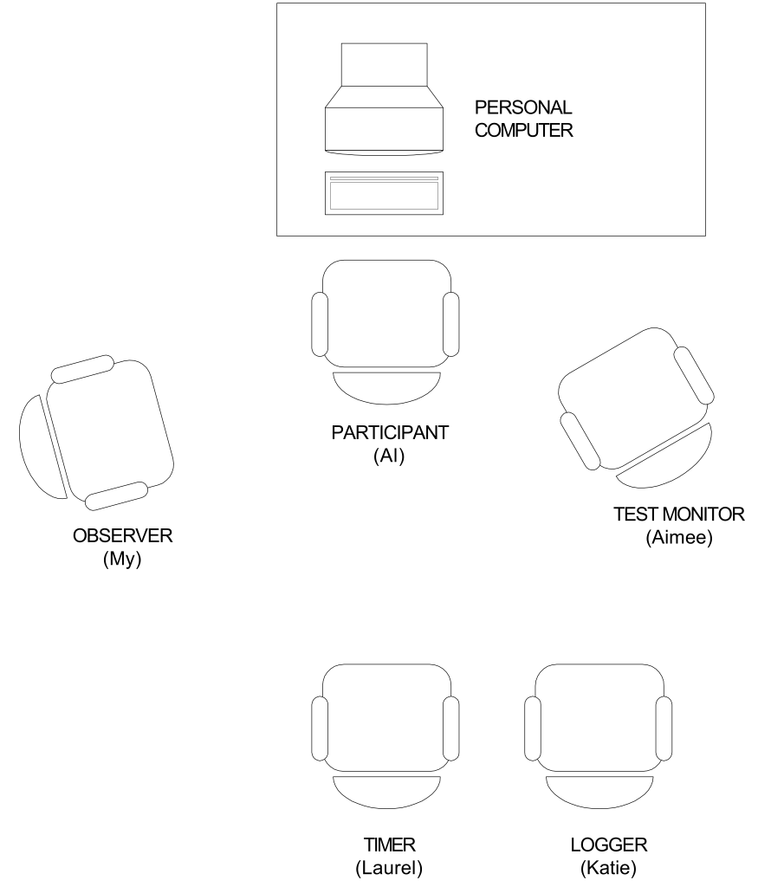
What’s a lab? Do I need one?
Computer / Concept
Participant
Observer
Facilitator
Timer
Logger
Rubin, Jeffrey. Handbook of Usability Testing. John Wiley & Sons, Inc.; 1994.

Slide 17
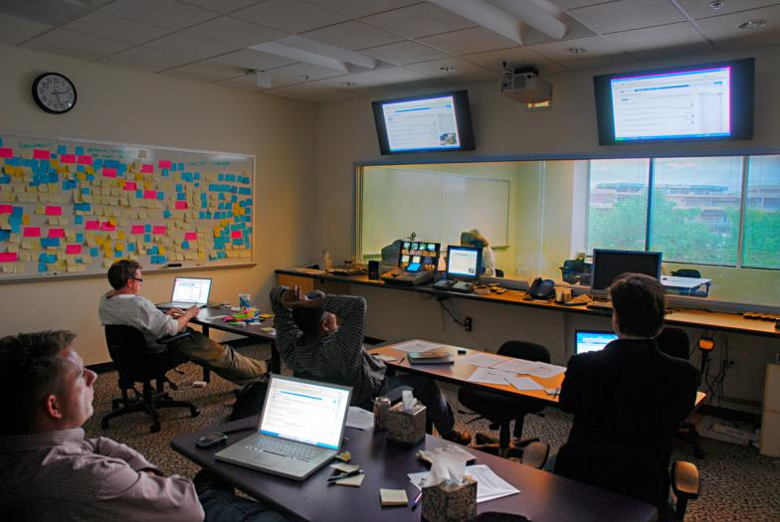
No, but it is nice
Anywhere
Any Phase
Anytime
Participant observed through 2 way mirror and on screens
Photo by Roebot at http://www.flickr.com/photos/roebot/2964156413/
http://www.flickr.com/photos/nzdave/491411546/sizes/o/in/photostream/
http://www.flickr.com/photos/nzdave/

Slide 18
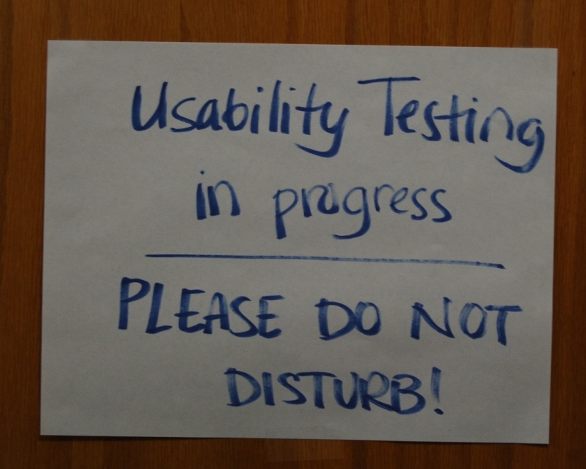
Portable Labs
Temporary setup
Laptop, external mouse
Capture screen, video and audio
Anywhere
Conference room
Waiting room
Share screen for observation
Photo by Roebot at http://www.flickr.com/photos/roebot/2964156413/

Slide 19
Remote Testing
Online screen sharing software
Capture screen, video and audio
Use separate phone line
Test setup and connections ahead of time!
Bandwidth, operating system, browser

Slide 20
Interacting with Participants

Slide 21
Welcome
Make sure the participant feels welcomed and appreciated
Emphasize you are not testing them, rather you are testing…
Encourage feedback, positive or negative
“I was not involved in the design of this so you can’t hurt my feelings”

Slide 22
Gain informed consent
Your responsibility to inform participant
Every time
Ethical and legal responsibility
Do no harm (physical, emotional)
Explain consent form
Rarely lose participants over form
Notes:
An ethical usability test should have the following:
Minimal risk
Informed consent
Minimize deception
Participant may withdraw at any time
Participant’s data should be kept confidential
Participant my withdraw data from the test.

Slide 23
Why Use a Script?
Promote consistency in conducting the test
Help remind you to welcome and thank people
Help remember to reset/configure between participants
Ensures NDAs and other legal requirements are not missed
Notes:
A script is a very important tool for ensuring a well run usability testing. It serves to keep things consistent, so you collect data consistently and don’t introduce bias. It also reminds you to welcome and thank people and to do any kind of resetting or reconfiguring necessary between sessions, like clearing the cache or history of a browser for example.
The main parts of a script include:
Here is a sample of script.
I often point out that I will be reading them some instructions in order to make sure that I cover everything with them.
Sometimes you will need to rephrase or clarify things for the participants.
Having some printed instructions and having the participants read them out loud and then summarize them for me is often useful because it gets them used to talking aloud and it makes sure that they understand what they are being asked to do.

Slide 24
Parts of a Script
Welcome to participants
Steps in test (forms, tutorials, tasks, questions)
Thank you to participants (and incentives if any)
Notes to yourself
Reset/configuration prompts
Notes:
A script is a very important tool for ensuring a well run usability testing. It serves to keep things consistent, so you collect data consistently and don’t introduce bias. It also reminds you to welcome and thank people and to do any kind of resetting or reconfiguring necessary between sessions, like clearing the cache or history of a browser for example.
The main parts of a script include:
Here is a sample of script.
I often point out that I will be reading them some instructions in order to make sure that I cover everything with them.
Sometimes you will need to rephrase or clarify things for the participants.
Having some printed instructions and having the participants read them out loud and then summarize them for me is often useful because it gets them used to talking aloud and it makes sure that they understand what they are being asked to do.

Slide 25
Facilitation
Remain passive (body, face)
Ask open-ended questions and let them talk
Avoid leading or giving clues
Encourage to elaborate
Probe don’t demand
Gently prompt to think-aloud if necessary
Let them tell you when they are done

Slide 26
Example Phrases
How does this compare with your expectations?
What specifically are you referring to?
What are you looking for?

Slide 27
Getting Participants Unstuck
It’s not a question of “if” but “when”
Embarrassed at what they perceive to be their fault
Not be able to articulate what they don’t understand
Don’t directly answer initial questions
Move on before frustrated, or take a break
Notes:
If you explore the problem a bit at a time, you will ferret out the root cause of the problem.
Verify that the user is trying to do what you thought.
→ Does the user share your understanding of how to go about it?
→ Can the user find and use the specific control or function needed to proceed with the task? (If not, then perhaps you have a clue what needs to be improved, e.g., if the user was unsure what the button would do, is there hover help now? And, if not, would that help? Would a brief “guide me” be helpful?
Remember: if you do have to help them complete a task, that counts as a Task Failure.

Slide 28
Progressive Assistance
What are you trying to do right now?
What do you think the next step is?
What would you do in this situation if you were at work?
Notes:
If you explore the problem a bit at a time, you will ferret out the root cause of the problem.
Verify that the user is trying to do what you thought.
→ Does the user share your understanding of how to go about it?
→ Can the user find and use the specific control or function needed to proceed with the task? (If not, then perhaps you have a clue what needs to be improved, e.g., if the user was unsure what the button would do, is there hover help now? And, if not, would that help? Would a brief “guide me” be helpful?

Slide 29
Hints
Do you see anything that might help you? (small hint)
Have you checked the Help? (medium hint)
What do you think the xxx button does? (large hint)
Notes:
If you explore the problem a bit at a time, you will ferret out the root cause of the problem.
Verify that the user is trying to do what you thought.
→ Does the user share your understanding of how to go about it?
→ Can the user find and use the specific control or function needed to proceed with the task? (If not, then perhaps you have a clue what needs to be improved, e.g., if the user was unsure what the button would do, is there hover help now? And, if not, would that help? Would a brief “guide me” be helpful?

Slide 30
Common Issues
Says it’s great, but cannot complete task
Watch what they DO, not what they SAY
Takes control - diverts to their issue
Show you are listening - writing it down
Refocus on study
Sometimes you need to end the session
Thank and give incentive

Slide 31
Activity!

Slide 32
Test an item in the room
Break into teams of ~3
Select item to test
Create a task
E.g. Using this phone set an alert for 45 minutes

Slide 33
Light Script
Five minutes in total
Introductions
Explain what you’ll be doing
Gain consent from participant to participate in your study
Task
Thank you for participating

Slide 34
Run the study
Identify Roles
Facilitator
Observer
One team member rotates
Conduct study with new team member as participant (5 minutes)
Participant moves to next study
Run again

Slide 35
Discussion
How did it feel?
What surprised you?

Slide 36
Improving Products with Usability Testing

Slide 37
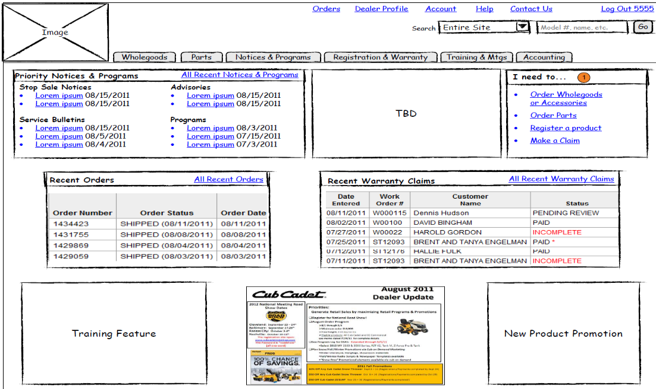
Can Test…
Websites, mobile apps, blenders, airport service
Clickability is recommended
Simulations or mockups
Prototypes
Help documentation
Processes (receipt of materials, purchase)

Slide 38
Tweak, Don’t Redesign
Small iterative changes
Make it better now
Don’t break something else
Take something away
Reduce distractions
Don’t add – question it
Rocket Surgery Made Easy: The Do-It-Yourself Guide to Finding and Fixing Usability Problems. By Steve Krug

Slide 39
Focus on Serious Problems
All interfaces have
usability problems
limited resources to fix them
more problems than resources
Less serious problems distract
Put intense focus on fixing most serious problems first
Adapted from: Rocket Surgery Made Easy: The Do-It-Yourself Guide to Finding and Fixing Usability Problems. By Steve Krug

Slide 40
How to Focus
Identify top 5 or 10 most serious issues
Top 3 from each observer’s list
Prioritize combined list
Commit resources for next effort
Stop
Adapted from: Rocket Surgery Made Easy: The Do-It-Yourself Guide to Finding and Fixing Usability Problems. By Steve Krug

Slide 41
Make Useful & Usable Recommendations Quickly

Slide 42
Just Do It!
Anywhere (conference room, remotely)
Any Stage (earlier in process the better)
Anytime (remote, un-moderated)
Start small
Test an idea (not a feature)
A few participants
Photo by Roebot at http://www.flickr.com/photos/roebot/2964156413/

Slide 43
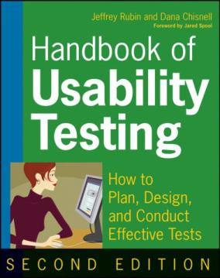
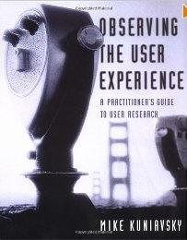
Recommended Readings
Notes:
Rocket Surgery Made Easy: The Do-It-Yourself Guide to Finding and Fixing Usability Problems
Book by Steve Krug
Letting Go of the Words: Writing Web Content that Works by Janice (Ginny) Redish
Handbook of Usability Testing: How to Plan, Design, and Conduct Effective Tests by Jeffrey Rubin and Dana Chisnell
Observing the User Experience: A Practitioner's Guide to User Research by Mike Kuniavsky Observing the User Experience: A Practitioner's Guide to User Research by Mike Kuniavsky

Slide 44
Contact Carol
in/CarolJSmith
@Carologic
slideshare.net/carologic

Slide 45
Resources

Slide 46
Myths of Usability Testing
Need a lab
Testing occurs at the end of the dev cycle
Must test everything
Need to test 100 people
A “good” test means no changes
Usability is “system testing”, “user-acceptance testing”, etc.
Need a large test team, each playing a specific role/part
Notes:
Let’s start with a few myths of usability testing.

Slide 47
Usability by the numbers…
80% of SW life cycle costs occur during maintenance
80% of maintenance costs are due to unmet or unforeseen user requirements
Only 20% are bugs or reliability problems
Typical software program released with 40 usability design problems
Over 70% of CIO's state that one of their biggest problems is communicating with users to understand their needs
Notes:
First bullet is from early 90’s I believe and comes originally from Claire Marie Karat and can be found in Mayhew and Bias’ Cost Justifying Usability.
2nd bullet is from Tom Landauer’s book of 1995/1996, The Trouble with Computers, and the last is from a 1998 Ernst & Young survey of CIO’s.

Slide 48
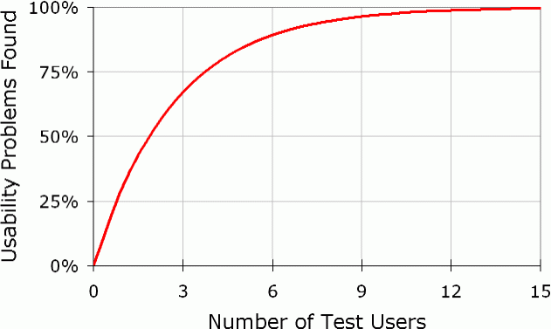
Number of Participants
Contentious issue
Nielsen - 5-7 participants uncover ~80% of major usability problems
IF representative
IF doing representative tasks.
Testing more = significant diminishing return.
Virzi and Carol Barnum
Small number of users is sufficient.
Number of Test Participants
http://www.useit.com/alertbox/20000319.html
Jakob Nielsen’s Alertbox. Why You Only Need to Test with 5 Users. March 19, 2000.
Notes:
In formative testing, most everyone has heard the 5-7 users is enough speech. But just to be clear the research that Nielsen did on this was that 5-7 users will uncover about 80% of the major usability problems IF you have representative users doing representative tasks. And that testing more users after that is a significant diminishing return so not worth testing more. This still gets debated in our field. But other researchers such as Virzi and Carol Barnum have also concluded similarly from their research, that a small number of users is sufficient.
One caveat is that if you are designing for a broader range of people, you will need a broader range of participants. And if you are designing for ADA standards, you will want to include people with the different disabilities that are being addressed in the design.

Slide 49
Recruitees
Could be
Customers
General consumers
Members of organization or company
Difficulty of recruiting
Specificity of screener
Availability/interest in study (doctors vs. consumers)
Experience (highly experienced vs. novice)

Slide 50
Recruiting Considerations
Accessibility of test location
Include people with disabilities
“We are all only temporarily able-bodied. Accessibility is good for us all.”
Language interpreters
Remote and on-site studies
Technology availability
Administrative rights
Internet connectivity
Quote by @mollydotcom at #stirtrek 2011 via @carologic

Slide 51
Data Collection Forms
Customize for each study
Space for writing notes – each scenario spelled out.
Include space for tickmarks regarding easily measurable activities.
E.g. Participant accesses video clip
E.g. Participant selects advertisement

Slide 52
Tool Considerations
In person or remote?
Lab or on-site?
Prototype limitations (can it be online?, is it a document or a clickable site?)
Number of observers, number of participants?
Number of facilitators?
Logging and video editing needs (time on task, highlight video creation)?
Surveys before or after?
Eye tracking?
Notes:
Finally we do want to mention that there are all kinds of tools out there to support usability testing that can really make things easier. None of these are necessary to do usability testing, but they can certainly make data collection and analysis much easier and less time consuming and also free up facilitators to concentrate much more on interacting with the user..
This is only a small sample of available tools and we are not endorsing any one tool over another.

Slide 53
Study Measurements
Success
% of tasks completed/not completed
Number of steps to accomplish task
Learning time
Number of errors
Number of times needed help
Satisfaction
Time on task
Photo By Kenyaboy7Andrew Chipley
http://www.flickr.com/photos/kenyaboy7/3749535540/
Notes:
There are many kinds of measurements you can take and different protocols you can use. The chosen protocol will affect your interaction with test participants and your note taking and the observations you record.
The kinds of measurements you take will drive some of the note taking/observations.

Slide 54
Interview & Observation Notetaking Form
Activity ______________________________________
Who are you observing? (e.g. SME in soft-goods manufacturing, application admin)
What is the situation? ___________________________ (e.g. phone interview, their work at their desk in person, remote usability study, etc.)
Date: __________________
Time: __________________
Location: ________________
Note-Taker: ______________
People (P) Who are you observing? Who else is involved in the experience? | Objects (O) What objects do they interact with? What apps? Phone, etc.? | Environment (E) Characteristics of the setting, number/types of interruptions | Messages (M) What is communicated? How is it transmitted? | Services (S) What services are available to them?
Physical What do they interact with?
Cognitive How associate meanings? How learn?
Social Interactions, decision making, scheduling, work?
Cultural What are shared norms, habits, values?
Emotional What emotions are expressed and how?
What are your biggest takeaways?
What did you learn? What surprised you? What is the participants need?
Watch for these types of observations and put additional Questions/Ideas on the back. Content in this document described by Vijay Kumar in his book: 101 Design Methods

Slide 55
Observer Rules
Everyone who observes a design session is asked to abide by a set of rules. The purpose of these rules is to minimize stress for the participants and to maximize the amount of information we get from the study.
Stay for the entire study
Distractions are unhelpful and participants may get the impression that you’re leaving because they’ve done something wrong (e.g. walking out in middle of a movie). If you can attend only part of a study, discuss with the facilitator beforehand to determine whether there is a way to accommodate this.
Don’t reveal information about the study to the participant
It is often more useful to explore an area of difficulty in detail rather than try to “get through” all the topics. The facilitator will track time so that we can cover as many of the important areas as possible.
Respect participants and the confidentiality of their data
We have promised the participants that their participation is confidential. This means that we should not include their names in any reports or other communication such as email, and we should refrain from discussing them by name outside the test setting.
Do not make negative comments about people—there is always a risk that a derogatory comment could be overheard or otherwise make its way back to the user.
Adapted from the book Paper Prototyping by Carolyn Snyder, published by Morgan Kaufmann Publishers. Copyright (c) 2003 Elsevier. All rights reserved.

Slide 56
Observer Rules (continued)
Remain silent and silence phones
You may notice something so surprising that you are tempted to laugh or exclaim out loud. This is not unusual. Unfortunately, participants might think you are laughing at them. Keep as quiet as possible. You will have opportunities to ask questions at the end. If necessary, pass a note to the facilitator.
Observe only - no questions or support
If reviewing an interface, it’s likely participants will have problems, and it is normal to feel a temptation to help. Please don’t. Instead, try to understand why it was that the user got stuck or went down the wrong path. It’s the facilitator’s role to get users back on track if they get really stuck. And if the facilitator poses a question during the test, he or she is asking the users, not you—please don’t answer unless the facilitator specifically directs a question to you.
Avoid “Design Questions” - Questions that ask the user their opinions about how to design aspects of the application (such as, “Where would you like to see these navigation buttons?”) can take a lot of time to answer and produce only limited results. Instead, focus on trying to understand the problem—we’ll come up with solutions later, outside the test.
In person, be conscious of your body language
Although most studies are interesting, not every moment will be fascinating. If something is happening that isn’t of interest to you but may be to others, sit quietly without fidgeting. Take notes to stay alert.
Adapted from the book Paper Prototyping by Carolyn Snyder, published by Morgan Kaufmann Publishers. Copyright (c) 2003 Elsevier. All rights reserved.

Slide 57
Ethics Resources
Treatment of human subjects
Web-based course
Gives certificate of completion http://cme.cancer.gov/clinicaltrials/learning/humanparticipant-protections.asp
Guidelines for writing informed consent
http://ohsr.od.nih.gov/info/sheet6.html
UXPA Code of Conduct
Notes:
Here are some resources regarding ethics. When I worked for a university I was required to take a course similar to the one listed in the first bullet. Additionally I had to apply to the Internal Review Board – an oversight body – and describe the test in detail and get approval before conducting the usability testing. I had to do something similar while a researcher at the National Institute of Standards and Technology.
We’ve given you some samples of informed consent forms but the second bullet on this slide will give you some guidelines for writing your own.
And finally, it is a good idea to be familiar with the UPA Code of Conduct as a usability professional.

Slide 58
NDA’s
Do I need a non-disclosure agreement (NDA)?
Maybe
Legal department (be friendly)
One-way, two-way*
AKA
Confidentiality agreement (CA)
Confidential disclosure agreement (CDA)
Proprietary information agreement (PIA)
Secrecy agreement (SA)
Notes:
Can someone tell me what an NDA is?
A non-disclosure agreement, or NDA, is a legal document that prohibits participants from discussion what they saw in the usability test unless, or until, your company makes that information publically available. They are typically used on products still under development that have not yet been announced.
NDA are used to protect intellectual property – either a corporation’s alone or both the corporation’s and participants designs, ideas etc. Often, companies will test out their early prototypes of a product that hasn’t be released to the market yet and they don’t want their designs and ideas talked about, released etc because of competition.
Consent forms are used to protect participants – the primary directive of involving people in testing products, services etc is to do no harm. This came out of incidents where people participated in medical or physical testing activities where they either weren’t aware of the risks and/or were actually harmed as a result of their participating in some study or activity. As a result, there are now strict guidelines when humans are involved in drug trials, new treatments, testing products etc. Some people don’t think this is needed for non-invasive things like usability testing designs or software, but depending on where you work, you may be required to include consent forms. That was the case with me as both a government employee and in academia where there are strict guidelines for involving humans. And I chose to carry that over into the corporate world also because I believe strongly in the ethics behind consent forms even if they are required.

Slide 59
References & Further Reading
Cato, John. User-Centered Web Design. Addison Wesley Longman; 2001.
Gaffney, Gerry. (2000) What is Card Sorting? Usability Techniques Series, Information & Design. http://www.infodesign.com.au/usabilityresources/design/cardsorting.asp
Hackos, JoAnn T., PhD and Redish, Janice C. User and Task Analysis for Interface Design. Wiley; 1998.
Henry, S.L. and Martinson, M. Evaluating for Accessibility, Usability Testing in Diverse Situations. Tutorial, 2003 UPA Conference. (Activity)
Krug, Steve. Don't Make Me Think: A Common Sense Approach to Web Usability.
Krug, Steve. Rocket Surgery Made Easy: The Do-It-Yourself Guide to Finding and Fixing Usability Problems
Kuniavsky, Mike. Observing the User Experience: a Practitioner's Guide to User Research. Morgan Kaufmann, 2003.
Mandel, Theo. The Elements of User Interface Design. Wiley; 1997.
Nielsen, Jakob and Robert L. Mack. Usability Inspection Methods. John Wiley & Sons, Inc. 1994.
Powell, Thomas A. The Complete Reference: Web Design. Osborne/McGraw-Hill; 2000.
Redish, Janice (Ginny). Letting Go of the Words: Writing Web Content that Works.
Rubin, Jeffrey and Dana Chisnell. Handbook of Usability Testing: How to Plan, Design, and Conduct Effective Tests. John Wiley & Sons, Inc.
Snyder, Carolyn. Paper Prototyping. Morgan Kaufmann Publishers. 2003 Elsevier.

