Slide 1
Planning and Estimation: Waterfall Versus Agile
Amber Pollastrini

Slide 2
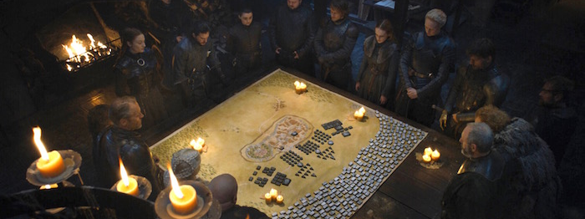
“In preparing for battle I have always found that plans are useless, but planning is indispensable.”
Dwight Einsenhower

Slide 3
Why is Planning Important?
Without planning, there’s no horizon to look at, and no way to know where you’re going.
The process of planning and estimating work involves dialogue about:
what a team is trying to achieve,
how they hope to achieve it and
how everything they’re doing together relates.
Key takeaways here are:
dependencies,
assumptions and
common vision of the goal.

Slide 4
Planning Paradigms
Waterfall
Agile
The project is separated into distinct phases
The plan is linear
Cost, scope and schedule are expected to remain constant, favoring only cost as variable
Business analysis prepares requirements before the project begins, which are not intended to change
The process is iterative, using sprints/iterations
The plan in incremental
Cost and schedule are expected to remain constant, scope is variable at sprint or increment boundaries
Product Owner works with teams to define requirements continuously (or the team reprioritizes with customer input)

Slide 5
Planning ala Waterfall
Business analysis defines all of the requirements in great detail.
The architecture and system design are decided up front, with as much of the work decomposed as possible.
Scope and time are generally fixed, leaving cost to be variable as time progresses.
A schedule, with dependencies, is used to chart out the critical path.
Bottom-up estimation is used to figure out the cost of the entire project up front.
Management reserve is built in to allow for margin of error.

Slide 6
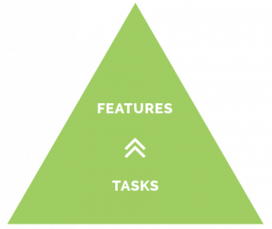
Waterfall: Bottom-Up estimation
Frequently done by a small group of subject matter experts (SMEs).
We start with the smallest tasks at the bottom.
We roll these up to areas of scope (in a work breakdown structure).
We use resource loaded tasks to determine the cost of the project.

Slide 7
Planning ala Agile
Product Owner defines acceptance criteria in a Feature, often posed as a hypothesis.
Architecture may be baked, but system design is somewhat emergent.
Time boxes replace a schedule.
Estimation is done in sprints/iterations that may roll up to an increment, but no further out.
Cost and time are generally fixed, leaving scope to be variable as time progresses.
Management reserve is not utilized.

Slide 8
Agile: Top Down estimation
Done with the team doing the work.
We start with a Feature and acceptance criteria.
The goal is to fit the work described into a time box. We keep carving the work into smaller chunks until it can be delivered in a sprint.
We use quick-fire estimates; a popular method is ‘poker planning’.
We use relative sizing.

Slide 9
Major Differences
Waterfall
Agile
Plans the entire project up front with a small group of SMEs
Only re-baselines during major shifts in scope (which is generally considered taboo)
Emphasizes extremely detailed estimates, rolling up to the whole
Commitment to delivering all the features to the client, as proposed
Plans small increments with the people doing the work
Promotes re-planning every sprint to provide a more reliable forecast of the roadmap
Relies on relative sizing and time boxes
Commitment to demonstrate value every sprint, per the priority of the customer/sponsor

Slide 10
Things They Have in Common
Lifecycle: requirements, design, develop, integrate/test, deploy. Essentially, a sprint is a really short project.
A product backlog (also sometimes called program backlog) is essentially the same as a work breakdown structure (WBS).
It’s best to go to the whiteboard to plan. The network diagram still reigns supreme. This exercise should drive the stories/tasks.
Tasks and stories should close within a week. (A day is always preferred.)
Dependencies matter.
The customer/sponsor needs should be central in decision making.
Both types of planning still don’t hit the mark every time. Why? Because humans.

Slide 11
Lean coffee

