Slide 1
Scaled Agile Requirements: What, When & How
Kim Hardy, Agile Coach

Slide 2
Topics
No matter what software development life-cycle (SDLC) is used to support development in your organization (waterfall, Scrum, SAFe, Kanban, etc.), they are each driven by requirements. But what kind of requirements? That is the question.
This presentation explores the what, when and how of scaled agile requirements and how they can support any life-cycle you choose.

Slide 3
What are Scaled Agile Requirements?

Slide 5
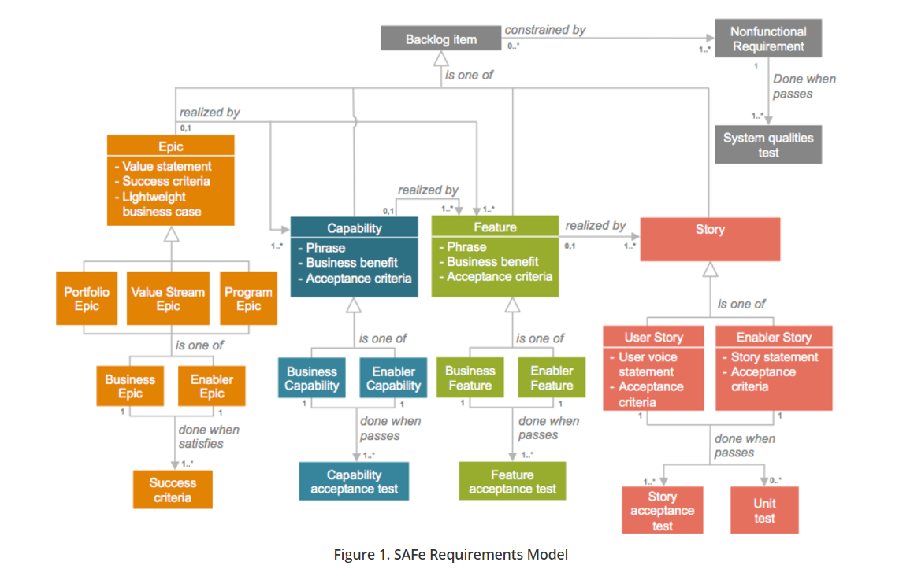

Slide 6
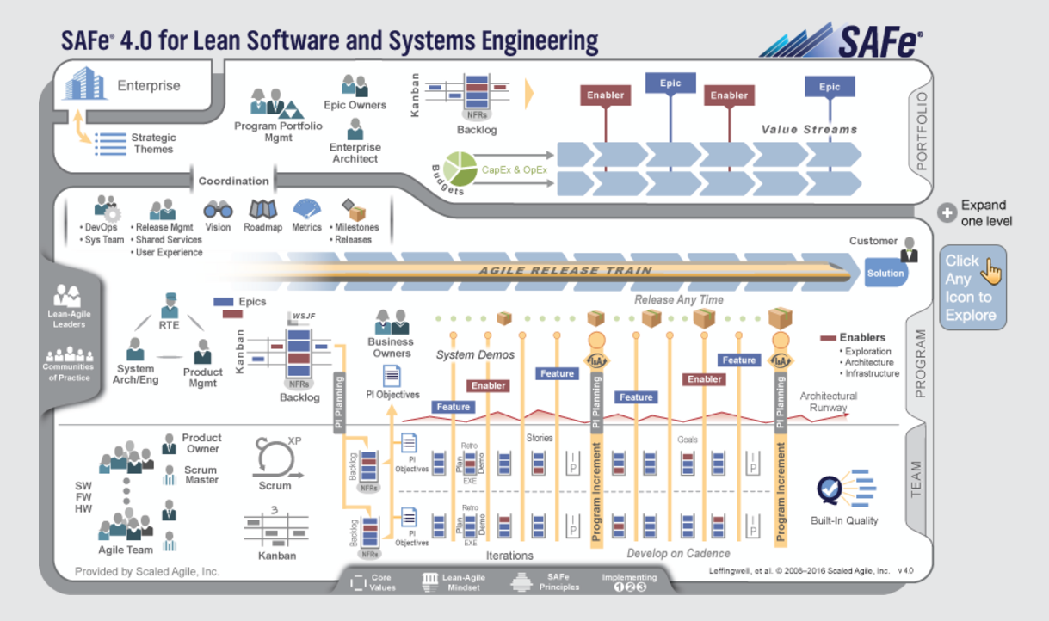

Slide 7
Strategic Theme
Initiative
Business Initiative
Enabler Initiative

Slide 8
Agile Release Cycles When & How

Slide 9
Agile Release Cycle Development
Program
They break down Initiatives into Features that are assigned to Release Cycles
Team
Development Teams break down Features into Stories and track them in Sprint Cycles
Program Teams define and track Initiatives

Slide 10
Definition Activities
Timeline (1 to 4 weeks)

Slide 11
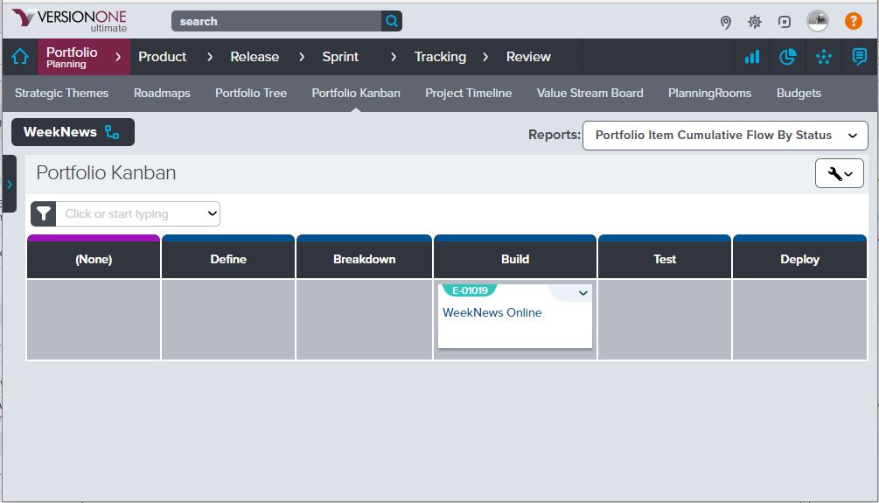

Slide 12
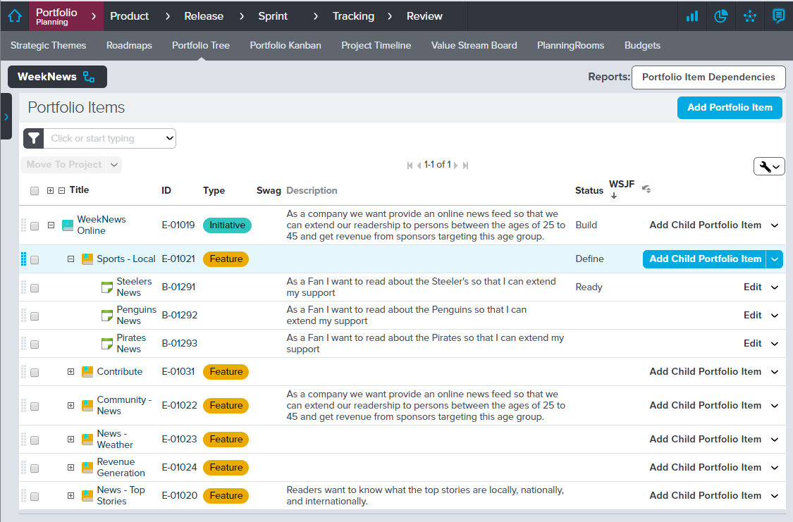

Slide 13
Sprint Cycle Activities
Timeline (1 to 4 weeks)

Slide 14
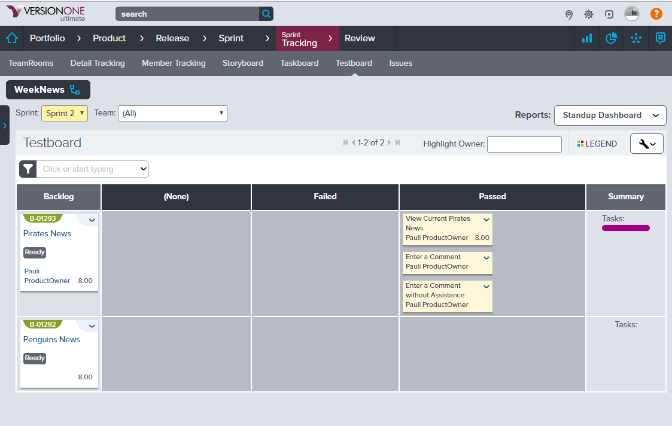

Slide 15
Waterfall What & When

Slide 16
Strategic Theme
Initiative
Business Initiative
Enabler Initiative

Slide 17
Waterfall
Timeline
Define
Plan
Develop
Test
Validate
Product Backlog
Story Acceptance Tests
I N V E S T

Slide 18
Different Program Frameworks
http://www.scaledagileframework.com/mixing-agile-and-waterfall-development-in-the-scaled-agile-framework/

Slide 19
Different Team Frameworks
Team
Scrum Teams
Program
Kanban Team
Waterfall Teams

Slide 20
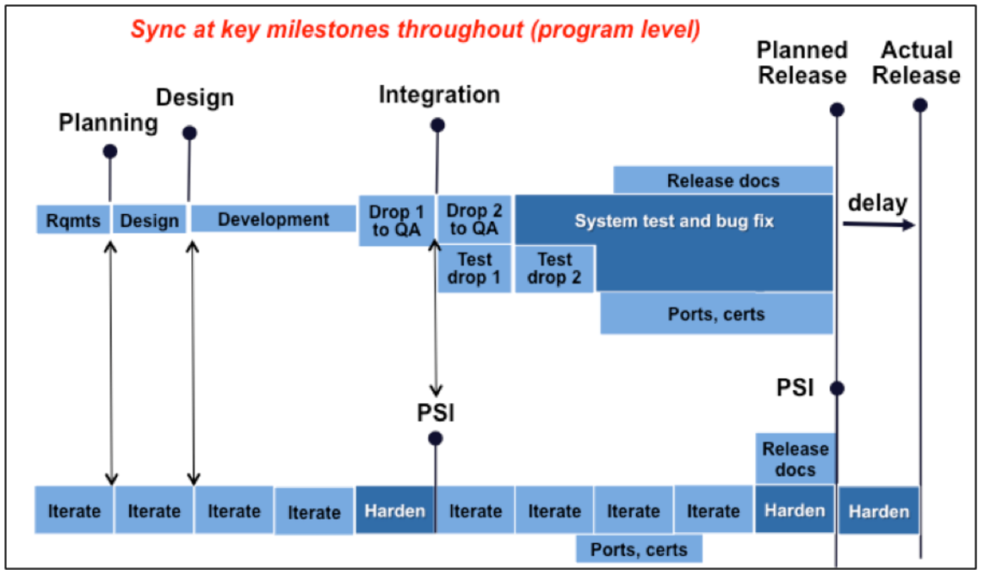
http://www.scaledagileframework.com/mixing-agile-and-waterfall-development-in-the-scaled-agile-framework/

