Slide 1
Designing Trustworthy AI:
A User Experience (UX) Framework
Carol J. Smith
Sr. Research Scientist - Human-Machine Interaction
Carnegie Mellon University’s Software Engineering Institute
Twitter: @carologic @sei_etc

Slide 2
Legal
Copyright 2020 Carnegie Mellon University.
This material is based upon work funded and supported by the Department of Defense under Contract No. FA8702-15-D-0002 with Carnegie Mellon University for the operation of the Software Engineering Institute, a federally funded research and development center.
NO WARRANTY. THIS CARNEGIE MELLON UNIVERSITY AND SOFTWARE ENGINEERING INSTITUTE MATERIAL IS FURNISHED ON AN "AS-IS" BASIS. CARNEGIE MELLON UNIVERSITY MAKES NO WARRANTIES OF ANY KIND, EITHER EXPRESSED OR IMPLIED, AS TO ANY MATTER INCLUDING, BUT NOT LIMITED TO, WARRANTY OF FITNESS FOR PURPOSE OR MERCHANTABILITY, EXCLUSIVITY, OR RESULTS OBTAINED FROM USE OF THE MATERIAL. CARNEGIE MELLON UNIVERSITY DOES NOT MAKE ANY WARRANTY OF ANY KIND WITH RESPECT TO FREEDOM FROM PATENT, TRADEMARK, OR COPYRIGHT INFRINGEMENT.
[DISTRIBUTION STATEMENT A] This material has been approved for public release and unlimited distribution. Please see Copyright notice for non-US Government use and distribution.
DM20-0086

Slide 3
AI’s Great Promise
Empower us with knowledge
Augment our effectiveness
We can—and must—ensure
that we keep humans safe and in control

Slide 4
Inadequate and abusive work
Lack of Trust
in Artificial Intelligence (AI)

Slide 5

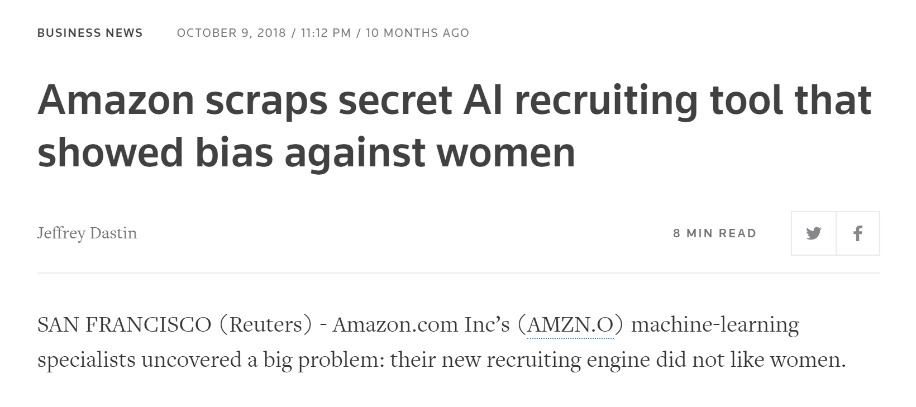
Assuming That Math Reduces Bias
Vetting applicant resumes
Notes:
Data: Resumes, mostly male candidates
Result: Taught itself that male candidates preferable
Penalized resumes: “women’s,” as in “women’s chess club captain”
Downgraded all-women’s colleges
Amazon scraps secret AI recruiting tool that showed bias against women
By Jeffrey Dastin. Reuters. October 9, 2018
https://www.reuters.com/article/us-amazon-com-jobs-automation-insight/amazon-scraps-secret-ai-recruiting-tool-that-showed-bias-against-women-idUSKCN1MK08G

Slide 6
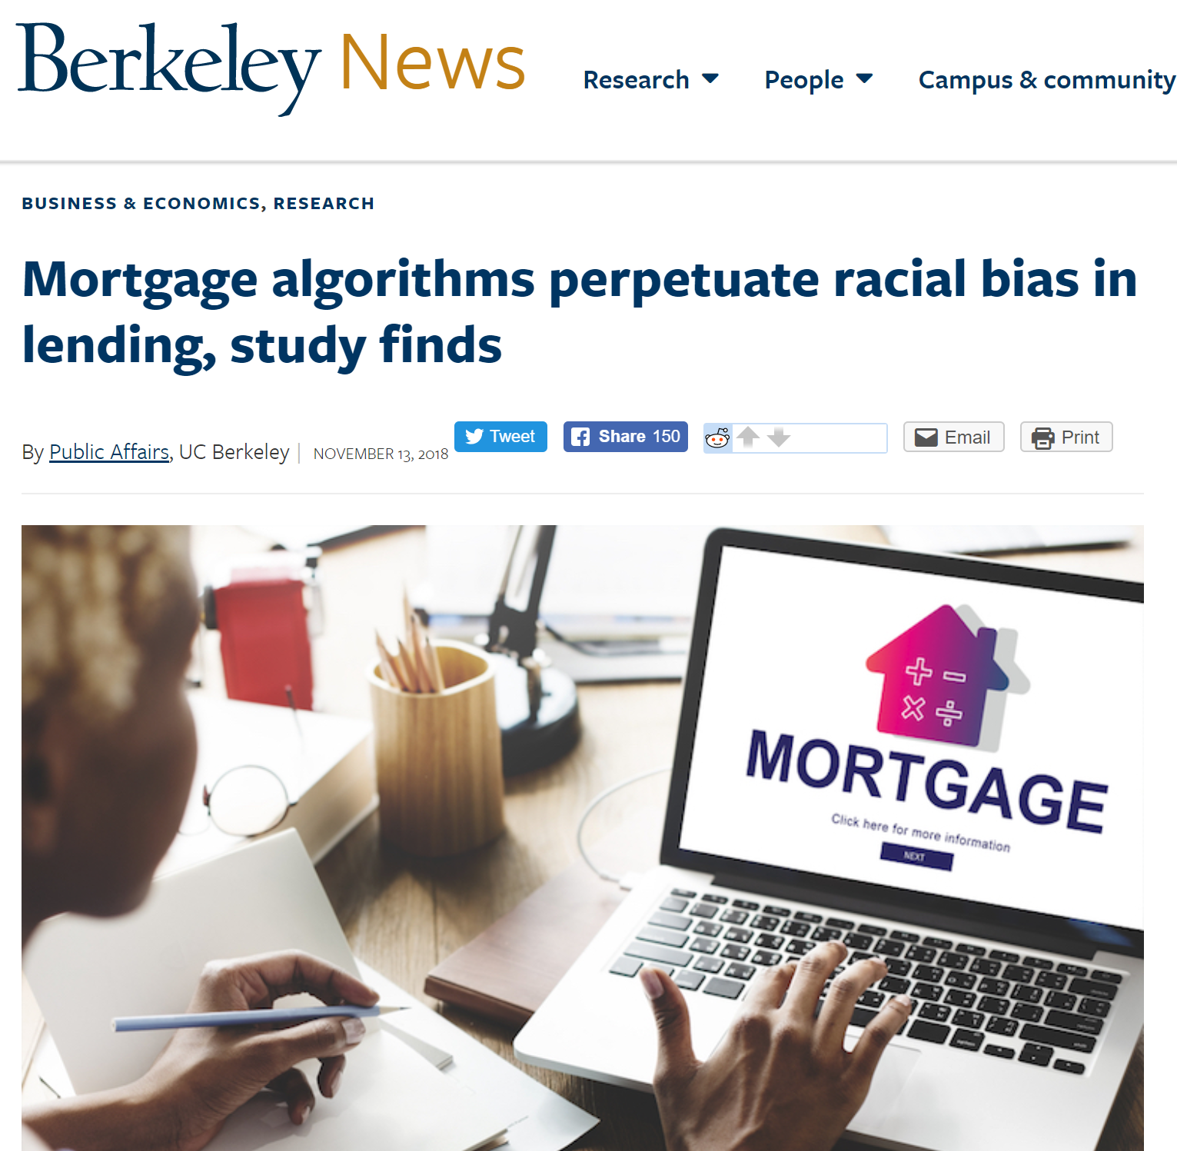
Embedding Existing Bad Behaviors
Determining interest rates for mortgage lenders
Notes:
Data: Historically charged higher interest rates to black and Latino borrowers
Result: ½ billion USD more in yearly interest than white borrowers with comparable credit scores
“Even if the people writing the algorithms intend to create a fair system, their programming is having a disparate impact on minority borrowers — in other words, discriminating...”
Mortgage algorithms perpetuate racial bias in lending, study finds By Public Affairs, UC Berkeley, Berkeley News, November 13, 2018
https://news.berkeley.edu/story_jump/mortgage-algorithms-perpetuate-racial-bias-in-lending-study-finds/

Slide 7
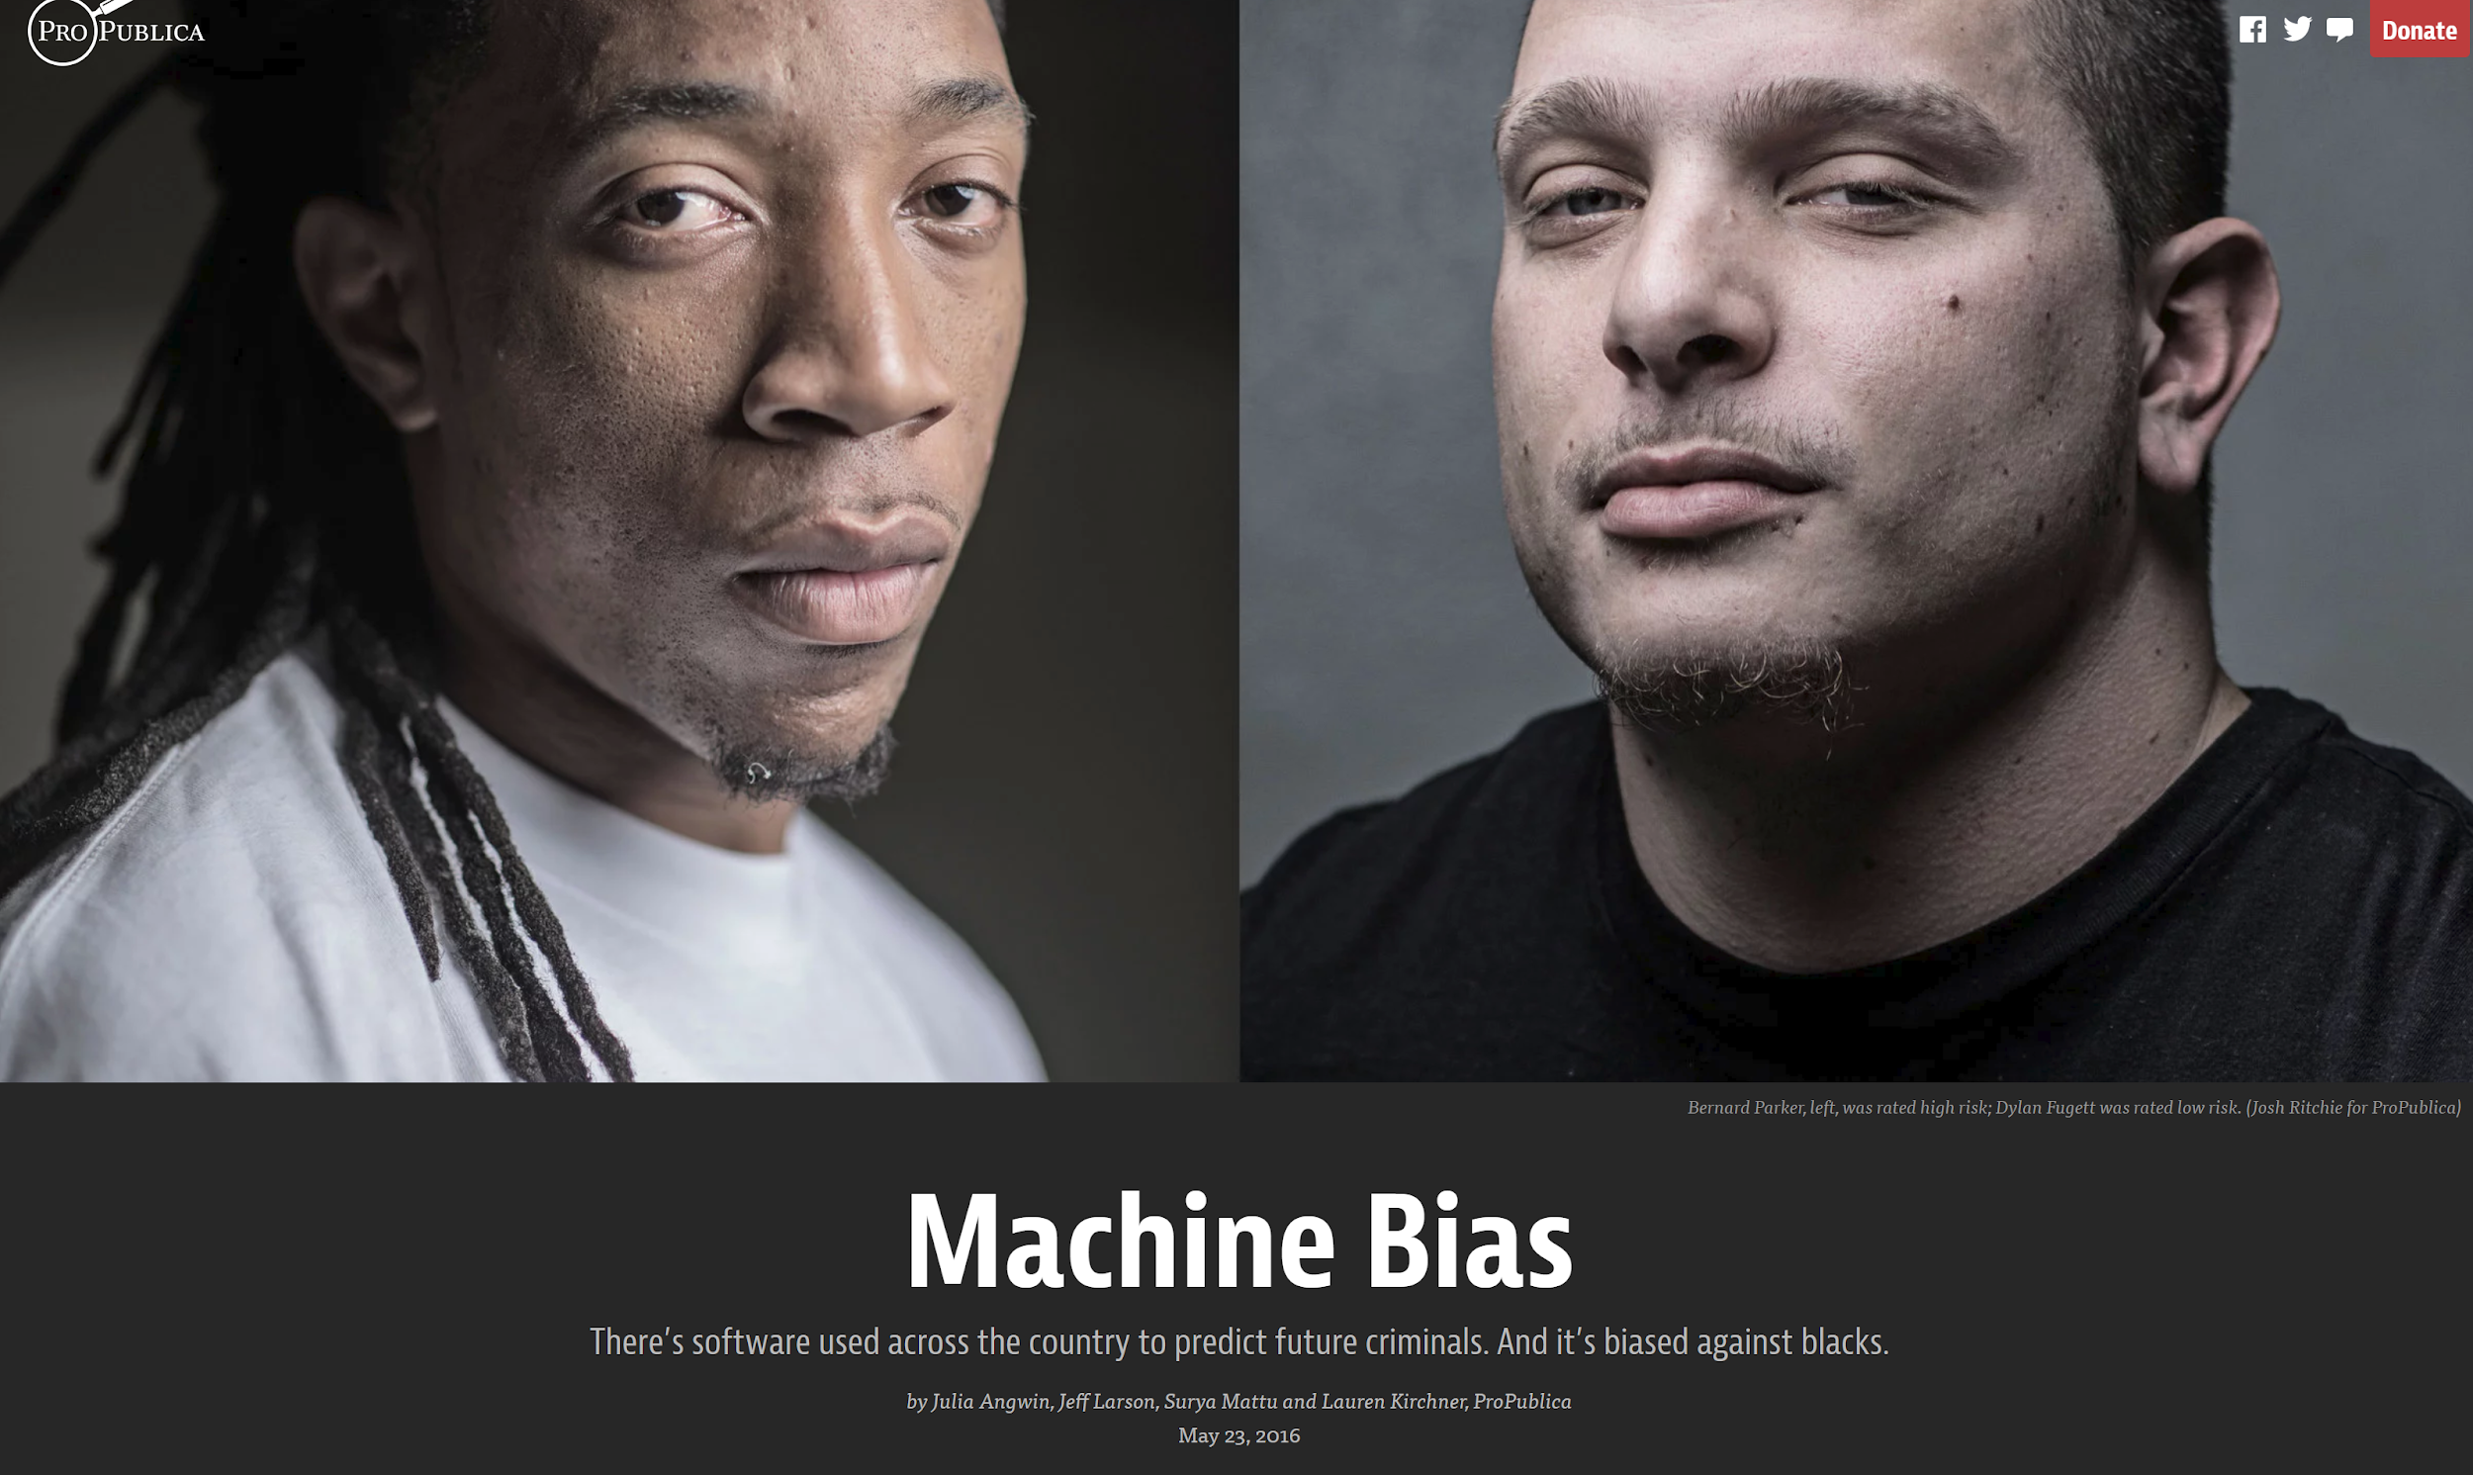
Dehumanizing thru Math
Predicting future criminal activity
Notes:
Machine Bias: There’s software used across the country to predict future criminals. And it’s biased against blacks.
By Julia Angwin, Jeff Larson, Surya Mattu and Lauren Kirchner, ProPublica. May 23, 2016
https://www.propublica.org/article/machine-bias-risk-assessments-in-criminal-sentencing
“When we verify the world through numbers, we lose the depth of meaning obtained through experience and interpretation, particularly in craft-based activities.” Thomas Wendt, Persistent Fools: Cunning Intelligence and the Politics of Design

Slide 8
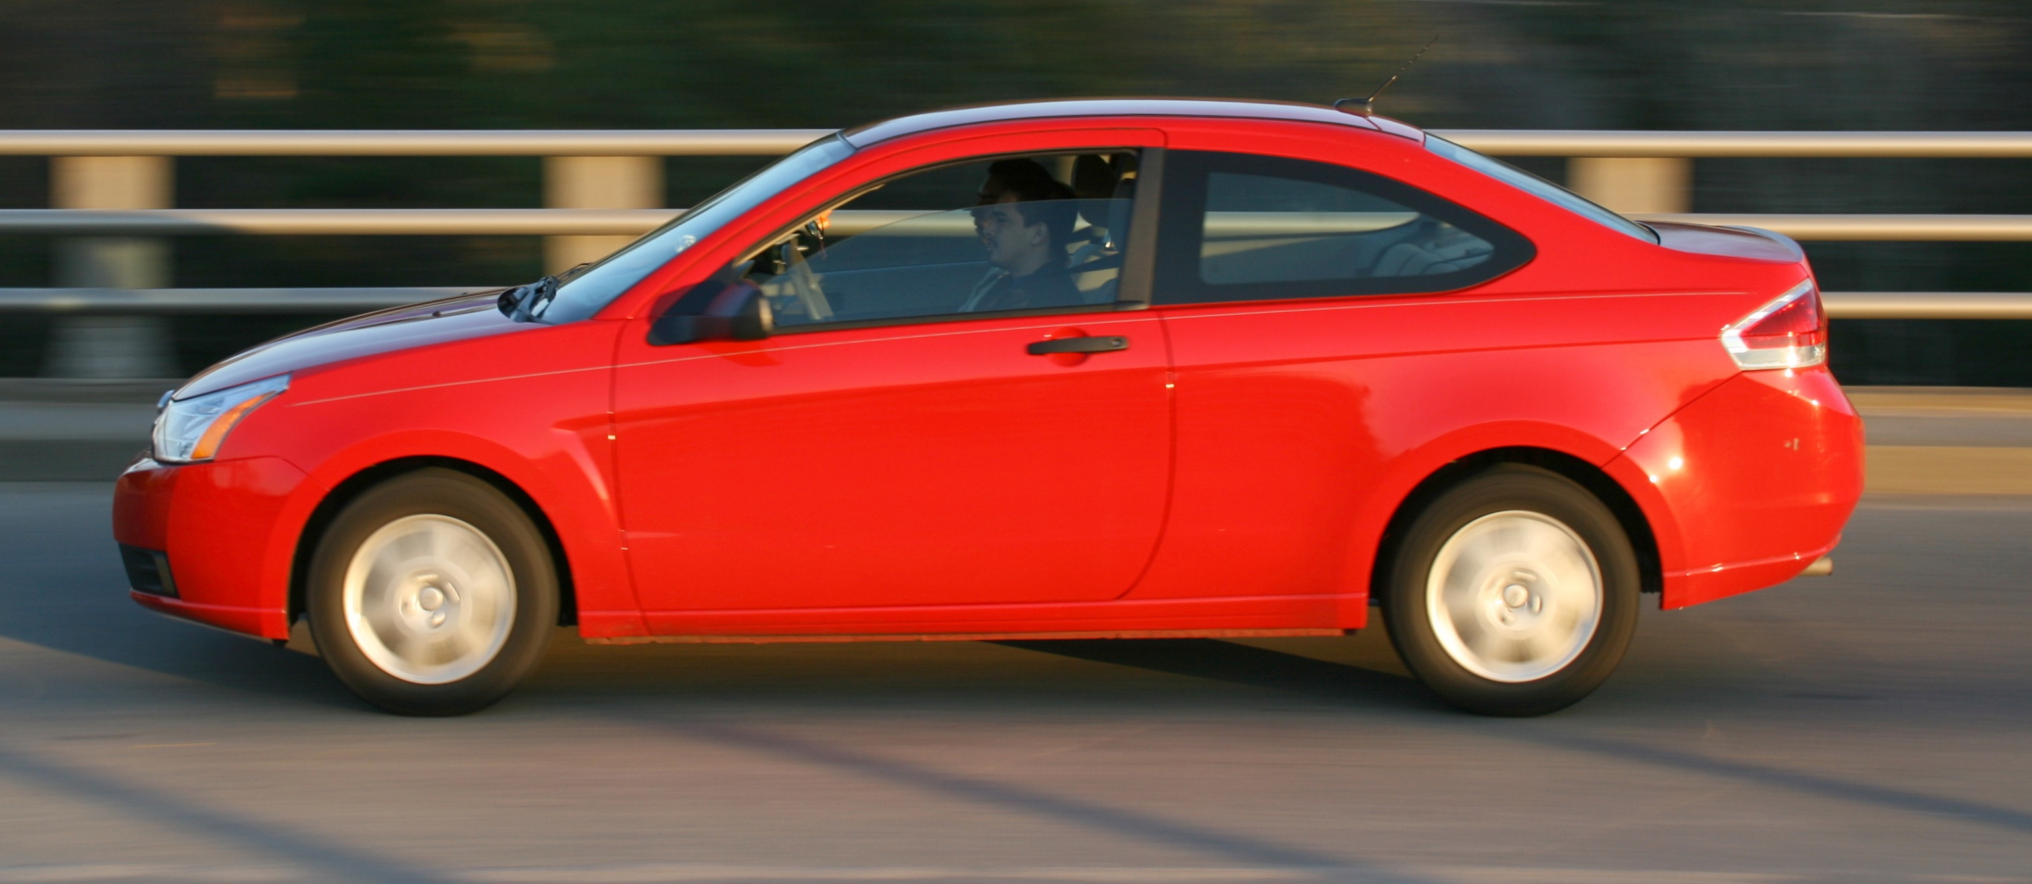
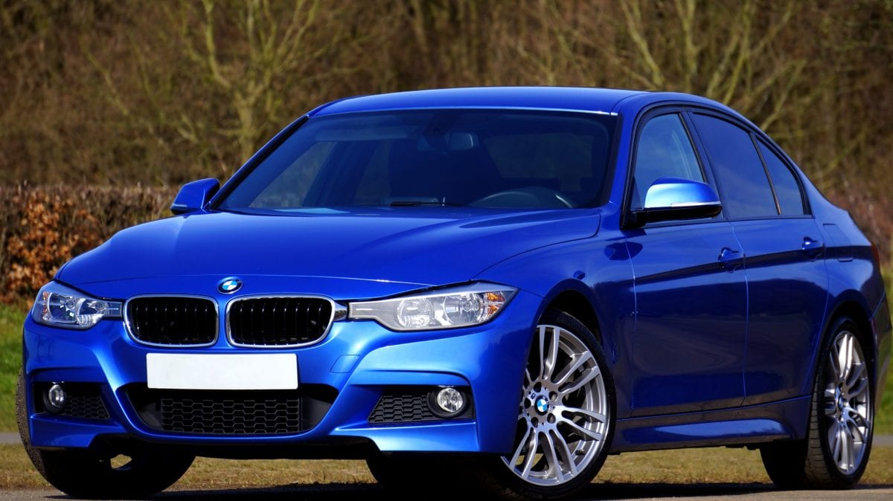
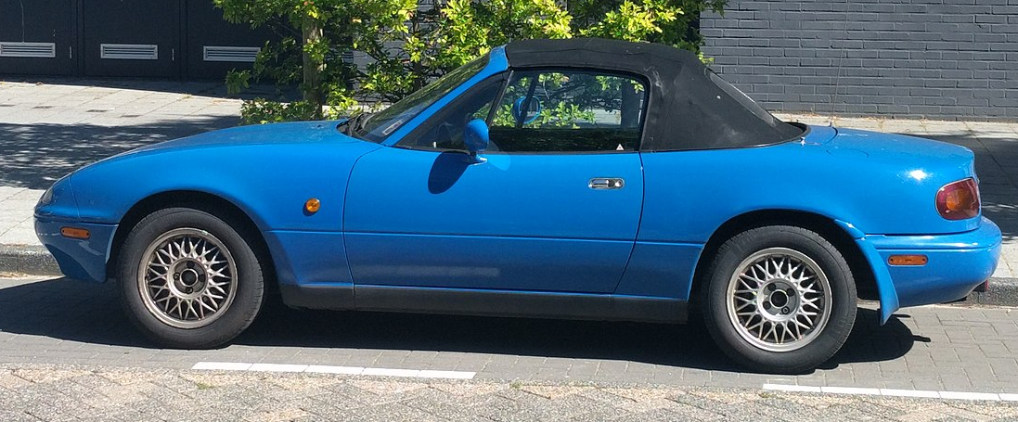
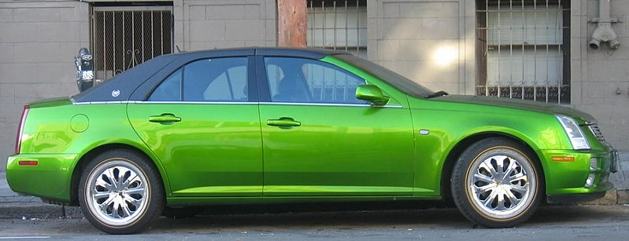
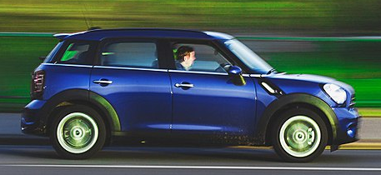
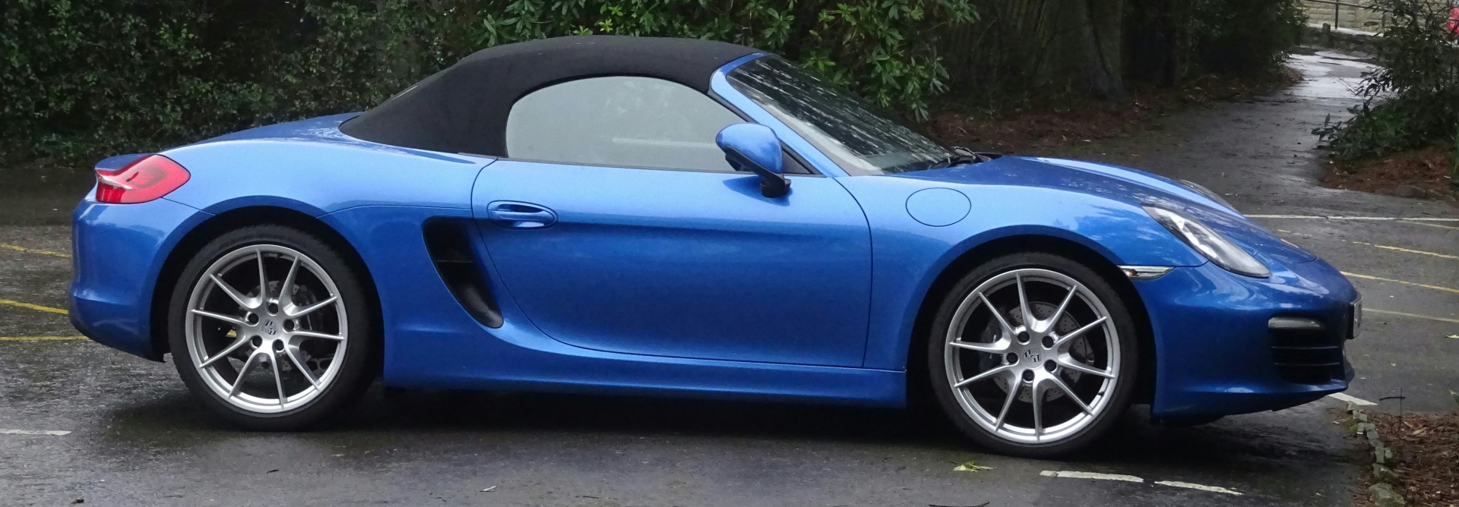
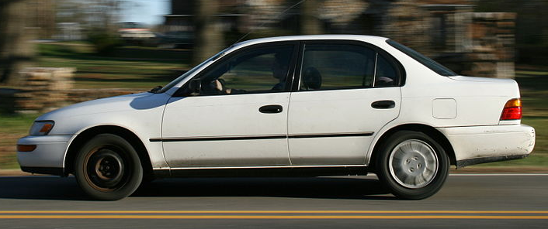
Bias in Training Set
Training Set
Data Encountered
Notes:
Training Set includes cars that are Red, Green and White.
AI System encounters Blue cars when it is deployed in the field.
How will it react?
Photos
Red car: Photo by Ildar Sagdejev https://commons.wikimedia.org/wiki/File:2009-03-20_Red_car_NB_on_S_Lasalle_St_in_Durham.jpg
Green car: Photo by pengrin. https://commons.wikimedia.org/wiki/File:Green_Cadillac.jpg
This image was originally posted to Flickr by pengrin™ at https://www.flickr.com/photos/pengrin/170208500/. It was reviewed on 14 December 2006 by FlickreviewR and was confirmed to be licensed under the terms of the cc-by-2.0.
White car: Photo by Ildar Sagdejev
https://commons.wikimedia.org/wiki/File:2009-03-20_White_car_EB_on_E_Geer_St_in_Durham.jpg
Blue car 1: https://pixnio.com/transportation-vehicles/cars-automobile/blue-car-wheel-vehicle-automobile-auto-sedan-transportation
Blue car 2: License: CC0 Public Domain. Alex Borland has released this “Blue Convertible Porsche Car Side” image under Public Domain license. https://www.publicdomainpictures.net/en/view-image.php?image=204542&picture=blue-convertible-porsche-car-side
Blue car 3: This image was originally posted to Flickr by pixellaphoto at https://flickr.com/photos/137643065@N06/24031452330. It was reviewed on 16 September 2016 by FlickreviewR and was confirmed to be licensed under the terms of the cc-zero. https://commons.wikimedia.org/wiki/File:Blue_Mini_Cooper_car_speeding.jpg
Blue Car 4: By Rudolphous - Noordwijk - Blue car. CC BY-SA 4.0 https://commons.wikimedia.org/w/index.php?title=Special:Search&limit=20&offset=20&profile=default&search=blue+car&advancedSearch-current={}&ns0=1&ns6=1&ns12=1&ns14=1&ns100=1&ns106=1#/media/File:Noordwijk_-_Blue_car.jpg

Slide 9
How can development teams create AI systems that are safe and trustworthy?

Slide 10
Today – Make Trustworthy AI Systems
Technology ethics and bias
Team qualities that lead to success
User Experience (UX) Framework
Checklist and Agreement to support work
Notes:
Diverse teams in inclusive environment
Shared set of technology ethics
Understand people’s needs and concerns for the system
Encourage deep conversations to align on clear expectations and mitigation plans
Use the HMT Framework’s Checklist and Agreement to design ethical AI experiences

Slide 11
Technology Ethics

Slide 12

Ethics
Based on well-founded standards of right and wrong
Standard of expected behavior that guides
the correct course of action
What impact does my work have?
What is Ethics? By Manuel Velasquez, Claire Andre, Thomas Shanks, S.J., and Michael J. Meyer. Markkula Center for Applied Ethics
https://www.scu.edu/ethics/ethics-resources/ethical-decision-making/what-is-ethics/
Notes:
Rights
Obligations
Benefits to society
Fairness
Specific virtues
What is Ethics? By Manuel Velasquez, Claire Andre, Thomas Shanks, S.J., and Michael J. Meyer. Markkula Center for Applied Ethics
https://www.scu.edu/ethics/ethics-resources/ethical-decision-making/what-is-ethics/

Slide 13

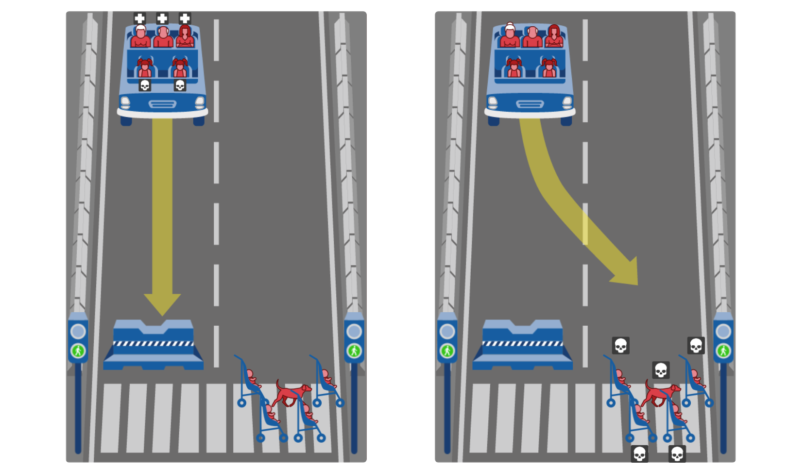
Not Trolley Problems (hypotheticals in-the-moment)
MIT Moral Machine Project
Images: 1) MIT Moral Machine Project: http://moralmachine.mit.edu/
2) Does the Trolley Problem Have a Problem? https://slate.com/technology/2018/06/psychologys-trolley-problem-might-have-a-problem.html
Notes:
More Complex and Nuanced
Original paper introducing the Trolley Problem: The Problem of Abortion and the Doctrine of the Double Effect by Philippa Foot. Oxford Review, no. 5, 1967
http://www2.pitt.edu/~mthompso/readings/foot.pdf
Images: MIT Moral Machine Project: http://moralmachine.mit.edu/.
Image 2: An anxious hypothetical trolley car lever operator
Does the Trolley Problem Have a Problem?
What if your answer to an absurd hypothetical question had no bearing on how you behaved in real life?
By Daniel Engber. Slate.com. June 18, 2018.
Image of anxious hypothetical trolley car lever operator by Lisa Larson-Walker
https://slate.com/technology/2018/06/psychologys-trolley-problem-might-have-a-problem.html

Slide 14
This is early, purposeful work
Not just about code
Challenging work about conduct, interactions, intents
Start with technology ethics
Benefits
  Harmonize cultural variations
  Balance to pace of change, industry pressure
  Explicit permission to consider and question breadth of implications
Notes:
https://www.linkedin.com/pulse/coming-tech-backlash-ross-mayfield
Tech still has time. Lean your products towards augmentation and job creation. Solidify your principles for what is humanely right against fear-mongering and scapegoating. Foster education, and not just what worked for you, but what junior colleges can do to help people transition. Tech company policy needs to go beyond the regulations that risk a single company wants to manage, and reflect it’s inherently progressive value set. Admit disruption is a bad word, and at least cause-relate your marketing and mission.
Does it Delight? Does it Pay? Does it Parse? Ethics for Digital Makers
https://medium.com/@lwelchman/does-it-delight-does-it-pay-does-it-parse-251b36efb5cd#.s43if7hhd
"This will be a hard shift. Our digital maker culture often demands that we make, and make, and make, never turning back to see the messes we might have created. Some of those messes are catching up to us and it’s important to pay attention and realize that knowledge and potential solutions are available to us. We can and must have the conversation and modulate our product development practices to ensure an ethically sound online experience for all of us. How can we teach machines to distinguish right from wrong when we’re not really clear on those answers ourselves?"
Technology is changing faster than ever, and that can lead to fear, uncertainty, doubt, anger, and unrest.
Examples abound in the tech industry of unethical behavior, arrogance, and lack of empathy. Culture and leadership have reputation for being unethical.
Technology is not neutral, but too often we jump into the new and the cool before considering the ramifications.
Ethical decisions are often not starkly good or bad, but nuances of behavior and habits. Just walking away isn’t the answer.
Pace of change
Avoid creating fear, uncertainty, doubt, anger, and unrest
Breadth of implications
Unintended consequences, ramifications
Understand nuances of behavior and habits
Consider ramifications
Don’t jump into the new and the cool too quickly
Counter perceptions in the industry
Unethical behavior, arrogance, and lack of empathy

Slide 15




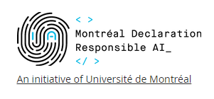
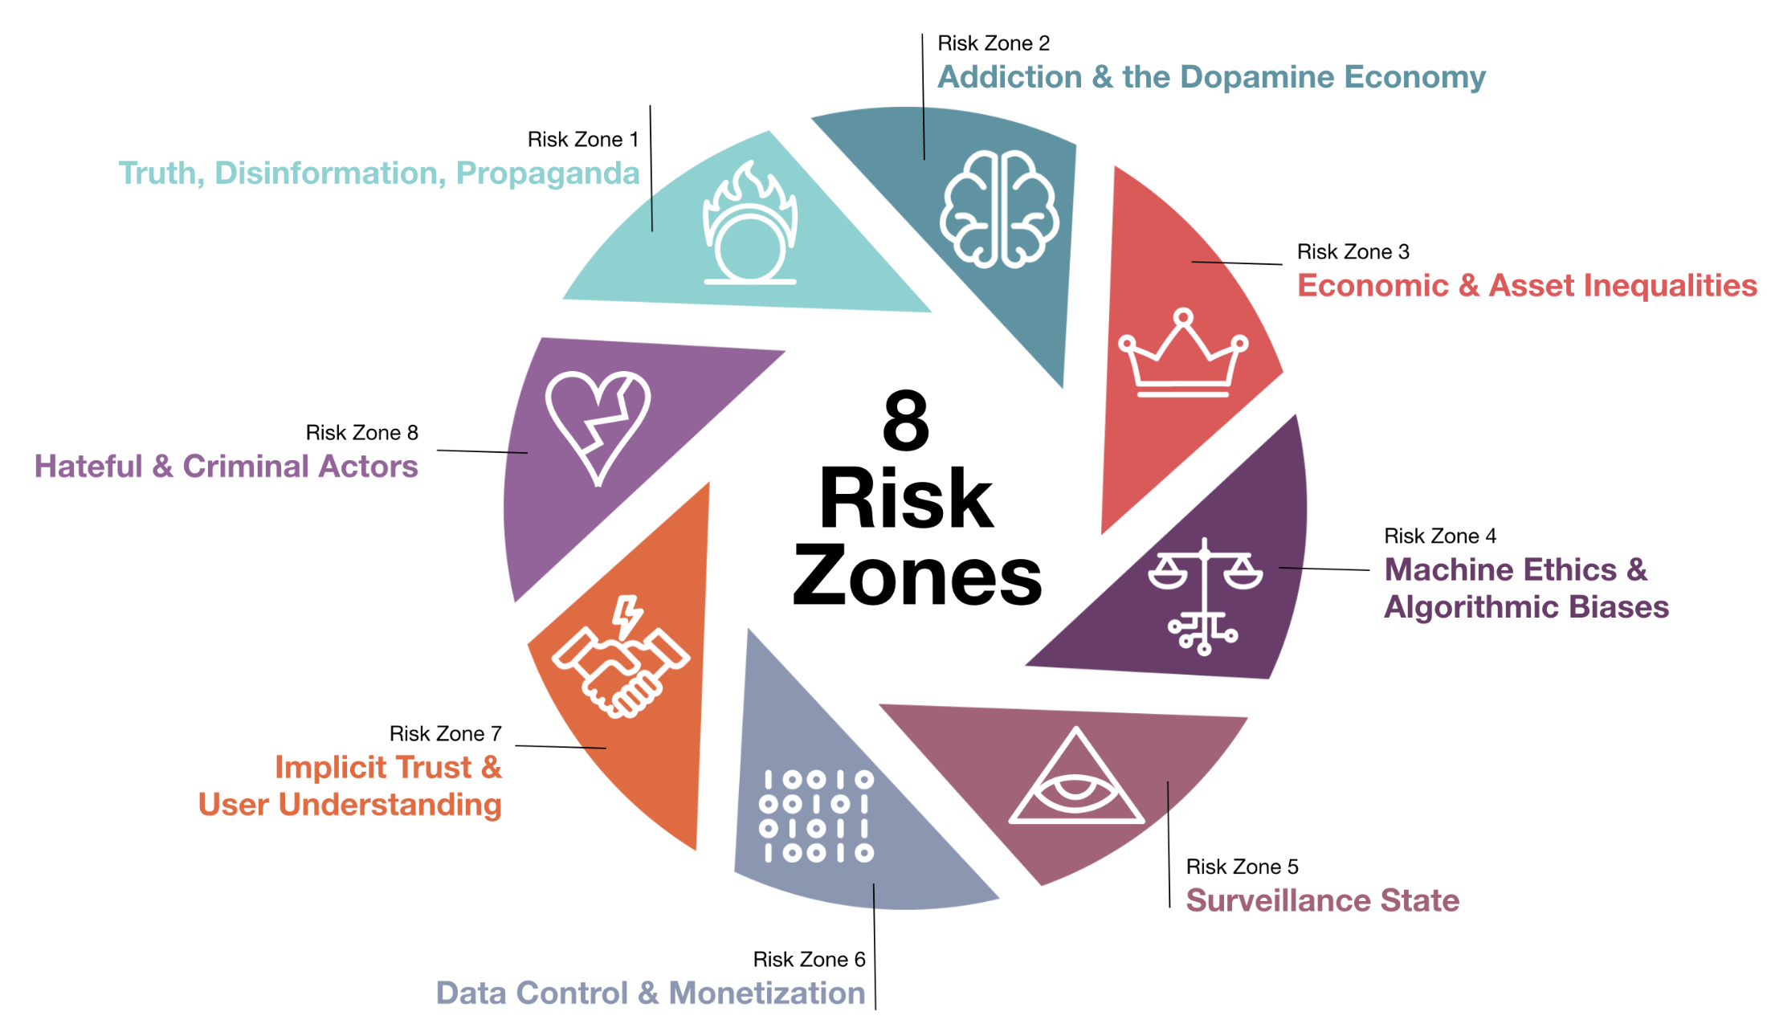

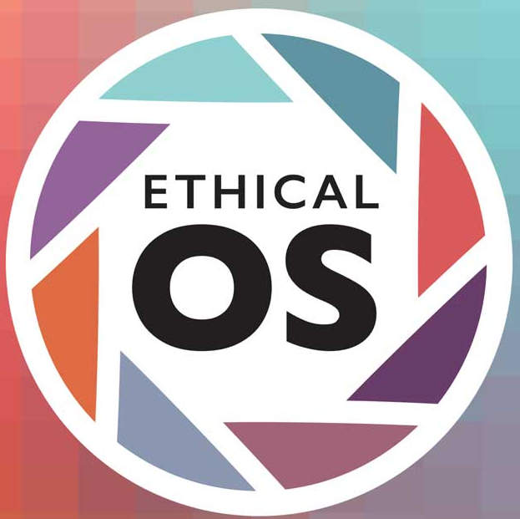
Adopt Technology Ethics
What do you value?
What lines won’t you cross?
Track progress
Notes:
What is too far?
What are you including?
socio-economic, cross cultural, international team
Links
Precedence - principles and codes
Université de Montréal. 2018. Montréal Declaration for a responsible development of artificial intelligence. 2018. Retrieved September 13, 2019 from: https://www.montrealdeclaration-responsibleai.com/the-declaration
ACM Code of Ethics and Professional Conduct - The Official Site of the Association for Computing Machinery's Committee on Professional Ethics: https://ethics.acm.org/
AI Now Institute - https://ainowinstitute.org/
Medium article: After a Year of Tech Scandals, Our 10 Recommendations for AI
Let’s begin with better regulation, protecting workers, and applying “truth in advertising” rules to AI https://medium.com/@AINowInstitute/after-a-year-of-tech-scandals-our-10-recommendations-for-ai-95b3b2c5e5
IBM Medium Article: Everyday Ethics for Artificial Intelligence: a Practical Guide for Designers and Developers by Adam Cutler, IBM Distinguished Designer, Artificial Intelligence Design; Milena Pribić, IBM Designer, Artificial Intelligence Design; and Lawrence Humphrey, IBM Designer, Artificial Intelligence Design: https://medium.com/design-ibm/everyday-ethics-for-artificial-intelligence-75e173a9d8e8
Google: our principles - https://blog.google/technology/ai/ai-principles/
Microsoft AI Principles - https://www.microsoft.com/en-us/ai/our-approach-to-ai
Everyday Ethics for Artificial Intelligence: A Practical Guide for Designers and Developers ibm.biz/everydayethics

Slide 16
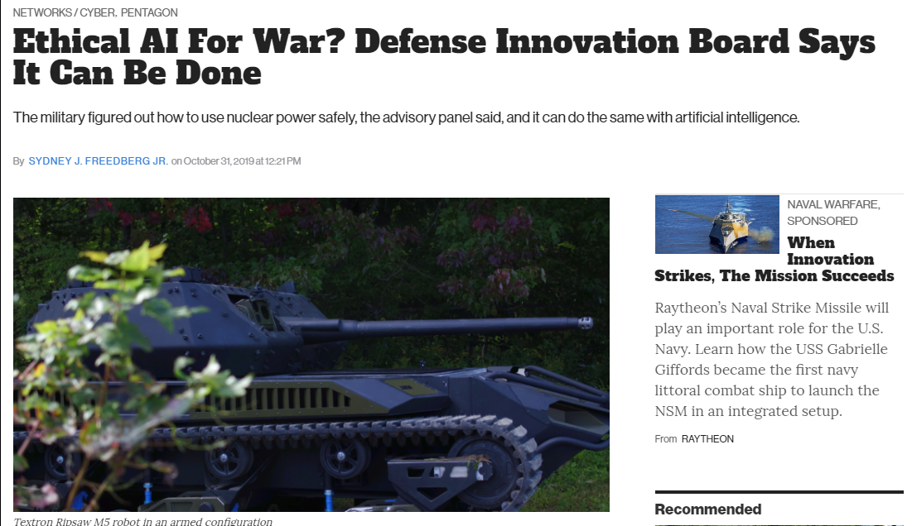
Notes:
Ethical AI For War? Defense Innovation Board Says It Can Be Done
The military figured out how to use nuclear power safely, the advisory panel said, and it can do the same with artificial intelligence.
By SYDNEY J. FREEDBERG JR. on October 31, 2019 at 12:21 PM
https://breakingdefense.com/2019/10/ethical-ai-for-war-defense-innovation-board-says-it-can-be-done/
AI “does not remove the responsibility from people… What is new about AI does not change human responsibility.”
- Michael McQuade
Defense Innovation Advisory Board member
and VP for research at Carnegie Mellon University

Slide 17
AI “does not remove the responsibility from people… What is new about AI does not change human responsibility.”
            - Michael McQuade
            Defense Innovation Advisory Board member
            and VP for research at Carnegie Mellon University
Notes:
Ethical AI For War? Defense Innovation Board Says It Can Be Done
The military figured out how to use nuclear power safely, the advisory panel said, and it can do the same with artificial intelligence.
By SYDNEY J. FREEDBERG JR. on October 31, 2019 at 12:21 PM
https://breakingdefense.com/2019/10/ethical-ai-for-war-defense-innovation-board-says-it-can-be-done/
AI “does not remove the responsibility from people… What is new about AI does not change human responsibility.”
- Michael McQuade
Defense Innovation Advisory Board member
and VP for research at Carnegie Mellon University

Slide 18
“When you know better, you do better.”
- Betty Easterly
Be aware and informed.

Slide 19
Bias

Slide 20
Data
Design
Solution
…are biased

Slide 21
Due to team member’s…
Social class
Resource availability
Education
Race, gender, sexuality
Culture, theology, tradition
More…

Slide 22
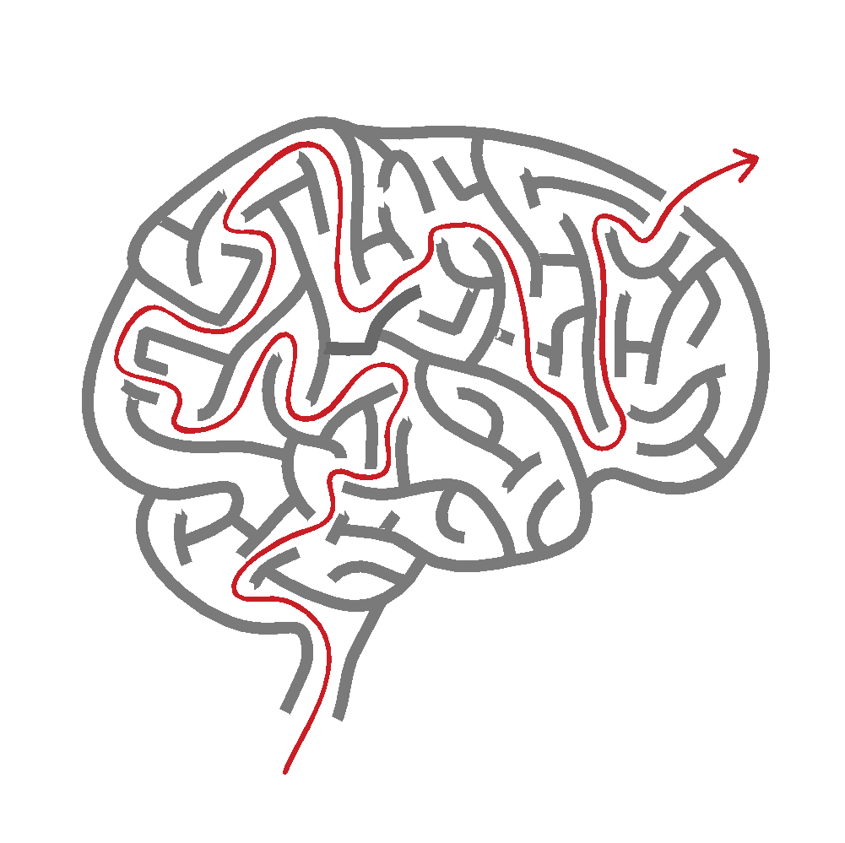
Bias: Human’s Mental Shortcut
Not inherently bad,
may be misapplied
Implicit = invisible (intuition)
Not necessarily in sync
with conscious beliefs
Can be managed and changed
Graphic by Karen Bachmann as presented in:
https://www.slideshare.net/karenbachmann/know-thyself-understanding-and-managing-biases
Notes:
Graphic by Karen Bachmann as presented in:
https://www.slideshare.net/karenbachmann/know-thyself-understanding-and-managing-biases

Slide 23
Start with building awareness and knowing ourselves
How are our biases
affecting our work?
Notes:
How can we best identify the biases within ourselves and our teams?
What tools and processes to control for bias we can introduce into our processes?
Where do biases emerge in our work?
Start with understanding your own bias
Don’t fall into the illusion of complete objectivity
Don’t be afraid to acknowledge bias

Slide 24
Team Qualities for Trustworthy AI

Slide 25

What is a diverse team?
Gender, race, culture,
education (school, program, etc.),
thinking process,
disability status,
and more…
Less shared experiences
Image: https://www.flickr.com/photos/byrawpixel/45739276192/in/photostream/
Created with love by rawpixel.com.
Download this image in high resolution under Creative Commons 0 at www.rawpixel.com.
Notes:
Non-typical schools, non-typical careers,
POC, LGBTQ, women (52% of world).
How People with Disabilities Use the Web: Overview
https://www.w3.org/WAI/intro/people-use-web
WAI-AGE Task Force of the Education and Outreach Working Group (EOWG), W3C
“When we do not design
for people with disabilities
we are being ableist”
- Anne Gibson @perpendicularme #ias18 Roundtable on Ethics
Hire/work with people affected by bias
https://www.flickr.com/photos/byrawpixel/45739276192/in/photostream/
Created with love by rawpixel.com.
Download this image in high resolution under Creative Commons 0 at www.rawpixel.com.

Slide 26
Diverse, Talented and Multi-Disciplinary
Includes skill set and problem framing approach
Context dependent
Data Scientists
Machine learning experts
Programmers
System architects
Product managers, etc.
Curiosity experts
  Understanding situation
  Abilities of people who will use system
  How system will be used
  Activate curiosity in others
  via UX activities
Social scientists, ethicists and more…
Notes:
Curiosity experts include: HCI, HMI, cognitive psychologists, digital anthropologists, and UX researchers

Slide 27
Inclusive Workplace Requirements
Representatively diverse leadership*
Individuals differences are acknowledged and accepted
  Bring "whole selves" to work
  Welcoming community environment
  Feel valued, connected, that we belong
*If not yet in place, promote people early or hire from outside
Notes:
Inclusivity resources from Forbes:
What An Inclusive Workplace Actually Looks Like, And Seven Ways To Achieve It
By Laura Hamill, Forbes Councils Member, Feb 4, 2019. https://www.forbes.com/sites/forbeshumanresourcescouncil/2019/02/04/what-an-inclusive-workplace-actually-looks-like-and-seven-ways-to-achieve-it/#21ec706e316b
Belonging In The Workplace: A New Approach to Diversity And Inclusivity. By Dr. Pragya Agarwal. Forbes. August 26, 2019
https://www.forbes.com/sites/pragyaagarwaleurope/2019/08/26/belonging-in-the-workplace-a-new-approach-to-diversity-and-inclusivity/

Slide 28

Why?
Focus more on facts
Process facts more carefully
More innovative
May “encourage greater scrutiny of each member’s actions,
keeping their joint cognitive resources sharp and vigilant.”
  “…become more aware of their own potential biases”
Why Diverse Teams Are Smarter. Harvard Business Review. https://hbr.org/2016/11/why-diverse-teams-are-smarter
Notes:
David Rock, Heidi Grant. 2019. Why Diverse Teams Are Smarter. (4 November, 2019). Retrieved September 13, 2019 from: https://hbr.org/2016/11/why-diverse-teams-are-smarter

Slide 29
Coalesce on Shared Set of Technology Ethics
1. Well-being
2. Respect for autonomy
3. Protection of privacy and intimacy
4. Solidarity
5. Democratic participation
6. Equity
7. Diversity inclusion
8. Prudence
9. Responsibility
10. Sustainable development
Montréal Declaration for a responsible development of artificial intelligence. https://www.montrealdeclaration-responsibleai.com/the-declaration
Notes:
Université de Montréal. 2018. Montréal Declaration for a responsible development of artificial intelligence. 2018. Retrieved September 13, 2019 from: https://www.montrealdeclaration-responsibleai.com/the-declaration

Slide 30

Diverse, inclusive leaders
Diverse,
Multi-Disciplinary Teams
Shared
Tech Ethics

Slide 31
Designing Trustworthy AI
UX Framework

Slide 32
How do we get there?
?
Trustable,
Ethical AI
Montréal Declaration for a responsible development of artificial intelligence. https://www.montrealdeclaration-responsibleai.com/the-declaration
Notes:
Accountable, De-risked, Respectful, Secure, Honest, Usable
Université de Montréal. 2018. Montréal Declaration for a responsible development of artificial intelligence. 2018. Retrieved September 13, 2019 from: https://www.montrealdeclaration-responsibleai.com/the-declaration

Slide 33
Conversations for Understanding
UX Framework guides AI development teams
Difficult Topics
  What do we value?
  Who could be hurt?
  What lines won’t our AI cross?
  How are we shifting power?*
  How will we track our progress?
*“How is this ML model shifting power?" @riakall #NeurIPS2019
Notes:
What is too far?
What are you including?
socio-economic, cross cultural, international team
*“How is this ML model shifting power?" https://twitter.com/riakall @riakall #NeurIPS2019
Initially inspired by
“3 guiding principles for ethical AI, from IBM CEO Ginni Rometty”
by Alison DeNisco. January 17, 2017, Tech Republic
http://www.techrepublic.com/article/3-guiding-principles-for-ethical-ai-from-ibm-ceo-ginni-rometty/

Slide 34
“Be uncomfortable”
- Laura Kalbag
Ethical design is not superficial.
Notes:
If we don’t ask tough questions, who will?
“Be uncomfortable.”
Ethical design is not superficial. By Laura Kalbag
https://laurakalbag.com/ethical-design-is-not-superficial/
Copyright © Laura Kalbag, 2019. RSS feeds

Slide 35
UX Framework for Designing Trustworthy AI
Ethical AI
Accountable
to humans
Cognizant
of speculative risks and benefits
Respectful
and secure
Honest
and usable
Notes:
1) Accountable to humans
2) Cognizant of speculative risks and benefits
3) Respectful and secure
4) Honest and usable

Slide 36
Accountable to Humans
Ensure humans have ultimate control
  Able to monitor and control risk
Human responsibility for final decisions
  Person’s life
  Quality of life
  Health
  Reputation
Ethical AI
Accountable
to humans
Speculative
Respectful
and secure
Honest
and usable

Slide 37

“Ensure humans can unplug the machines”
– Grady Booch
TED Talk, Grady Booch, Scientist, Philosopher, IBM’er https://www.ted.com/talks/grady_booch_don_t_fear_superintelligence
Notes:
Secure back doors and brakes
“Ensure humans can unplug the machines” – Grady Booch, TED Talk
Grady Booch, Scientist, Philosopher, IBM’er https://www.ted.com/talks/grady_booch_don_t_fear_superintelligence

Slide 38
Cognizant of Speculative Risks and Benefits
Identify full range of
  Harmful, malicious use, as well as good, beneficial use
  Blind spots and unwanted/unintended consequences
Ethical AI
Accountable
to humans
Speculative
Respectful
and secure
Honest
and usable

Slide 39
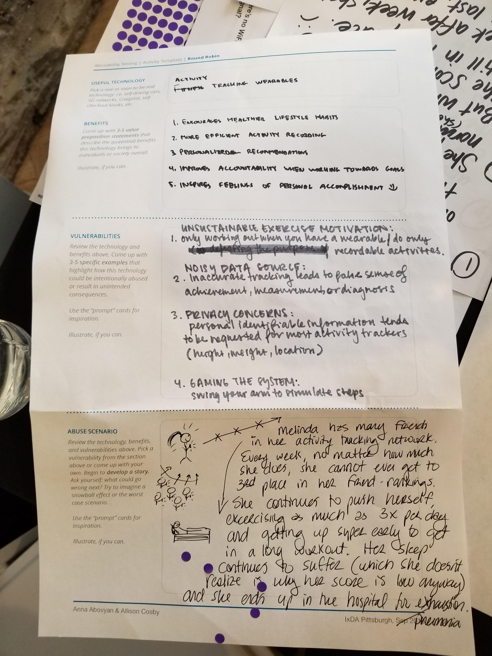
Speculative: Conduct research and activate curiosity
Abusability Testing
Speculate about misuse and abuse
Create “Black Mirror” episodes
  Severe abuse and consequences
Template by: Anna Abovyan & Allison Cosby, IxDA Pittsburgh, Sep 2019
Notes:
Image of Template created by Anna Abovyan & Allison Cosby for Abusability Testing activity conducted at IxDA Pittsburgh, Sep 2019.
UX in the Age of Abusability. The role of Composition, Collaboration, and Craft in building ethical products.
Dan Brown. Sep 18, 2018. https://greenonions.com/ux-in-the-age-of-abusability-797cd01f6b13
Black Mirror, Light Mirror: Teaching Technology Ethics Through Speculation. Casey Fiesler. Oct 15, 2018.
https://howwegettonext.com/the-black-mirror-writers-room-teaching-technology-ethics-through-speculation-f1a9e2deccf4

Slide 40
Speculative: Create communication & mitigation plans
Plan for unwanted consequences
Misuse and Abuse of AI System
  Who can report?
  To whom?
  Turn off?
  Who notified?
  Consequences?
Notes:
Image: Google’s tensor processing units:
https://www.nytimes.com/2018/02/12/technology/google-artificial-intelligence-chips.html

Slide 41
Respectful and Secure
Values of humanity, ethics, equity, fairness,
accessibility, diversity and inclusion
Respect privacy and data rights
Make system robust, valid and reliable
Provide understandable security
Ethical AI
Accountable
to humans
Speculative
Respectful
and secure
Honest
and usable

Slide 42
Fair: Remove unwanted bias in data
Show awareness of known and desirable bias
Acknowledge issues
Overcommunicate on issues

Slide 43
Honest and Usable
Value transparency with the goal of engendering trust
Explicitly state identity as an AI system
Ethical AI
Accountable
to humans
Speculative
Respectful
and secure
Honest
and usable

Slide 44
UX Framework: Being intentional, keeping people safe
Ethical AI
Accountable
to humans
Cognizant
of speculative risks and benefits
Respectful
and secure
Honest
and usable
Notes:
Monitor system
Identify warning signs
Use plain language
1) Accountable to humans
2) Cognizant of speculative risks and benefits
3) Respectful and secure
4) Honest and usable

Slide 45
Designing Trustworthy AI
Checklist and Agreement

Slide 46
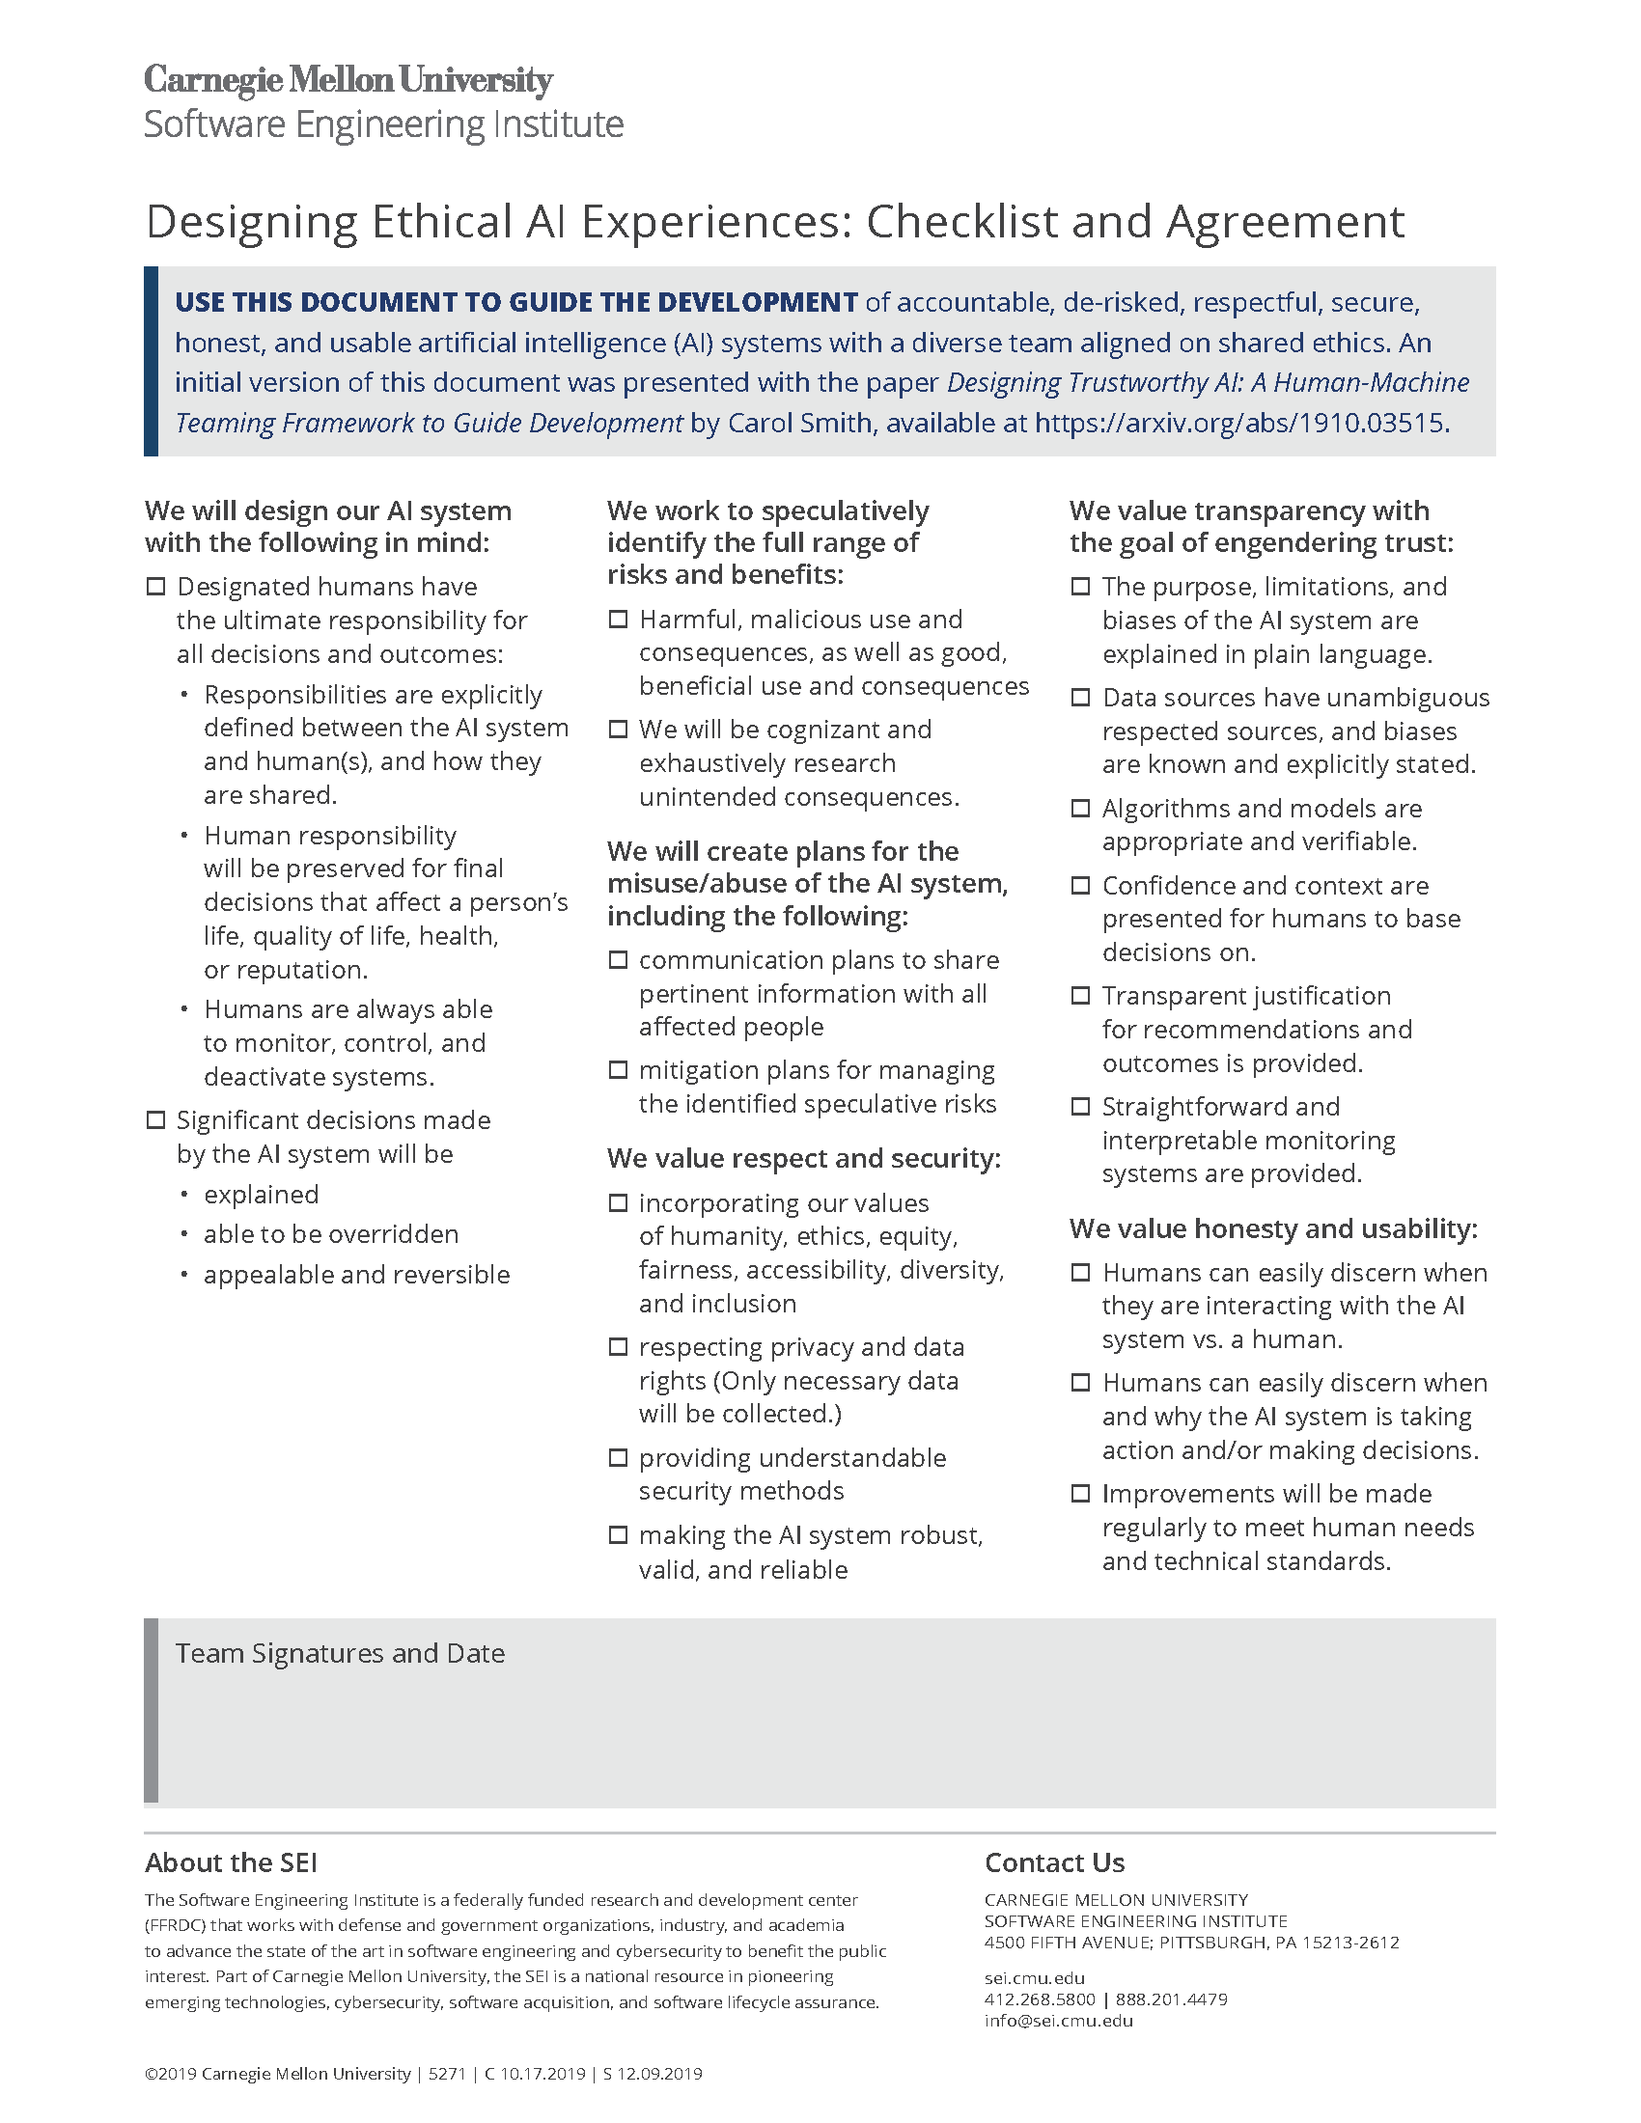
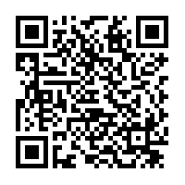
Checklist and Agreement
Pair with Tech Ethics
  Bridge gap between
  “do no harm” and reality
Reduce risk and unwanted bias
Mitigation planning
Support inspection
Checklist and Agreement - Downloadable PDF: https://resources.sei.cmu.edu/library/asset-view.cfm?assetid=636620
Notes:
Checklist and Agreement - Downloadable PDF: https://resources.sei.cmu.edu/library/asset-view.cfm?assetid=636620

Slide 47
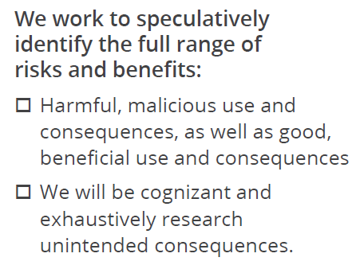
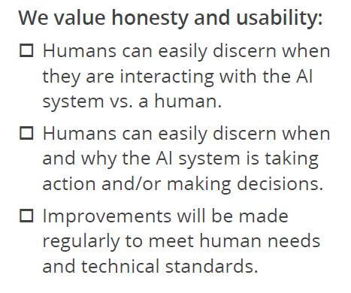
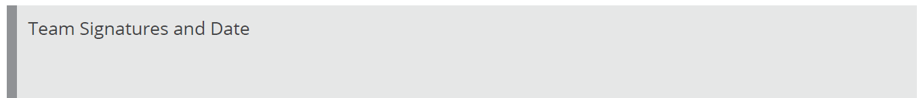
Prompts for Conversations

Slide 48

Reward team members for finding ethics bugs
Dr. Ayanna Howard
- on the Artificial Intelligence Podcast with Lex Fridman
Notes:
Dr. Ayanna Howard: Human-Robot Interaction and Ethics of Safety-Critical Systems |
Artificial Intelligence Podcast with Lex Fridman
https://www.youtube.com/watch?v=J21-7AsUcgM
More about Dr. Ayanna Howard: https://howard.ece.gatech.edu/

Slide 49
Evangelize for human values
Ethical. Transparent. Fair.
Notes:
Create AI systems that are accountable, de-risked, respectful, secure, honest, and usable

Slide 50
We aren’t perfect, AI won’t be perfect
Diverse teams, inclusive environments
Adopt tech ethics
Encourage deep conversations (Checklist)
Activate curiosity; be speculative; imaginative
Make trustworthy AI systems
Ethical AI
Accountable
to humans
Speculative
Respectful
and secure
Honest
and usable
Notes:
Diverse teams in inclusive environment
Shared set of technology ethics
Understand people’s needs and concerns for the system
Encourage deep conversations to align on clear expectations and mitigation plans
Use the HMT Framework’s Checklist and Agreement to design ethical AI experiences

Slide 51
Apply What You Have Learned Today
Next week:
  Identify initial set of technology ethics
  Introduce tech ethics and Checklist to 1 team*
3 months:
  Formally adopt technology ethics based on learnings
  Run 1+ abusability workshop
  Expand use of Checklist
6 months:
  Measure progress (e.g. proactiveness, quality conversations vs. surprises)
*Experiment to learn
Notes:
See change in curiosity, speculation, and proactivity on ethical issues
Next week:
Identify set of technology ethics (if you haven’t already)
Introduce tech ethics and Checklist to 1 team (diverse and invested in ethics)
3 months:
Formally adopt technology ethics (if you haven’t already)
Run an abusability workshop (on anything) or other curiosity activating activities
Expand the use of the Checklist to additional teams
Within six months you should:
Have teams using the checklist as part of their regular work

Slide 52
Carol J. Smith
Email: cjsmith@sei.cmu.edu
Twitter: @carologic @sei_etc
SEI on HMT: https://sei.cmu.edu/research-capabilities/all-work/display.cfm?customel_datapageid_4050=197910
Notes:
Checklist and Agreement - Downloadable PDF: https://resources.sei.cmu.edu/library/asset-view.cfm?assetid=636620
SEI page for Designing Trustworthy Artificial Intelligence: https://sei.cmu.edu/research-capabilities/all-work/display.cfm?customel_datapageid_4050=197910

Slide 53
Designing Trustworthy AI
Resources

Slide 54
Notes:
AI Engineering: 11 Foundational Practices
White Paper, September 2019, Software Engineering Institute
https://resources.sei.cmu.edu/library/asset-view.cfm?assetid=633647
This initial set of recommendations can help organizations that are beginning to build, acquire, and integrate artificial intelligence capabilities into business and mission systems.

Slide 55
Resources
Black Mirror, Light Mirror: Teaching Technology Ethics Through Speculation. Casey Fiesler. Oct 15, 2018. https://howwegettonext.com/the-black-mirror-writers-room-teaching-technology-ethics-through-speculation-f1a9e2deccf4
UX in the Age of Abusability. The role of Composition, Collaboration, and Craft in building ethical products. Dan Brown. Sep 18, 2018. https://greenonions.com/ux-in-the-age-of-abusability-797cd01f6b13
AI​ ​Now​ ​2017​ ​Report, New York University, and AI Now https://assets.ctfassets.net/8wprhhvnpfc0/1A9c3ZTCZa2KEYM64Wsc2a/8636557c5fb14f2b74b2be64c3ce0c78/_AI_Now_Institute_2017_Report_.pdf
“How IBM is Competing with Google in AI.” The Information. https://www.theinformation.com/how-ibm-is-competing-with-google-in-ai?eu=2zIDMNYNjDp7KqL4YqAXXA
“The business case for augmented intelligence” by Nancy Pearson, VP Marketing, IBM Cognitive. https://medium.com/cognitivebusiness/the-business-case-for-augmented-intelligence-36afa64cd675#.qqzvunakw
“Inside Intel: The Race for Faster Machine Learning” http://www.intel.com/content/www/us/en/analytics/machine-learning/the-race-for-faster-machine-learning.html

Slide 56
More Resources
“Update: Why this week’s man-versus-machine Go match doesn’t matter (and what does)” by Dana Mackenzie. Science Magazine. Mar. 15, 2016 http://www.sciencemag.org/news/2016/03/update-why-week-s-man-versus-machine-go-match-doesn-t-matter-and-what-does
“For IBM’s CTO for Watson, not a lot of value in replicating the human mind in a computer.” by Frederic Lardinois (@fredericl), TechCrunch, Posted Feb 27, 2017. https://techcrunch.com/2017/02/27/for-ibms-cto-for-watson-not-a-lot-of-value-in-replicating-the-human-mind-in-a-computer/
“Google and IBM: We Want Artificial Intelligence to Help You, Not Replace You” Most Powerful Women by Michelle Toh. Mar 02, 2017. Fortune. http://fortune.com/2017/03/02/google-ibm-artificial-intelligence/
“Facebook scales back AI flagship after chatbots hit 70% f-AI-lure rate - 'The limitations of automation‘” by Andrew Orlowski. Feb 22, 2017. The Register https://www.theregister.co.uk/2017/02/22/facebook_ai_fail/
“Microsoft is deleting its AI chatbot's incredibly racist tweets” by Rob Price. Mar. 24, 2016. Business Insider UK. http://www.businessinsider.com/microsoft-deletes-racist-genocidal-tweets-from-ai-chatbot-tay-2016-3

Slide 57
Even More Resources
“IBM’s Automated Radiologist Can Read Images and Medical Records” by Tom Simonite, February 4, 2016. Intelligent Machines, MIT Technology Review. https://www.technologyreview.com/s/600706/ibms-automated-radiologist-can-read-images-and-medical-records/
“The IBM, Salesforce AI Mash-Up Could Be a Stroke of Genius” by Adam Lashinsky, Mar 07, 2017. Fortune. http://fortune.com/2017/03/07/data-sheet-ibm-salesforce/
"Google can now tell you're not a robot with just one click" by Andy Greenberg. Dec. 3, 2014. Security: Wired. https://www.wired.com/2014/12/google-one-click-recaptcha/
“Essentials of Machine Learning Algorithms (with Python and R Codes)” by Sunil Ray, August 10, 2015. Analytics Vidhya. https://www.analyticsvidhya.com/blog/2015/08/common-machine-learning-algorithms/
IBM on Machine Learning https://www.ibm.com/analytics/us/en/technology/machine-learning/
“At Davos, IBM CEO Ginni Rometty Downplays Fears of a Robot Takeover” by Claire Zillman, Jan 18, 2017. Fortune. http://fortune.com/2017/01/18/ibm-ceo-ginni-rometty-ai-davos/
“Google and IBM: We Want Artificial Intelligence to Help You, Not Replace You” by Michelle Toh. Mar 02, 2017. Fortune. http://fortune.com/2017/03/02/google-ibm-artificial-intelligence/

Slide 58
Yes, even more resources
Video: “IBM Watson Knowledge Studio: Teach Watson about your unstructured data” https://www.youtube.com/watch?v=caIdJjtvX1s&t=6s
“The optimist’s guide to the robot apocalypse” by Sarah Kessler, @sarahfkessler. March 09, 2017. QZ. https://qz.com/904285/the-optimists-guide-to-the-robot-apocalypse/
“AI Influencers 2017: Top 30 people in AI you should follow on Twitter" by Trips Reddy @tripsy, Senior Content Manager, IBM Watson . February 10, 2017 https://www.ibm.com/blogs/watson/2017/02/ai-influencers-2017-top-25-people-ai-follow-twitter/
“3 guiding principles for ethical AI, from IBM CEO Ginni Rometty” by Alison DeNisco. January 17, 2017, Tech Republic http://www.techrepublic.com/article/3-guiding-principles-for-ethical-ai-from-ibm-ceo-ginni-rometty/
"Transparency and Trust in the Cognitive Era" January 17, 2017 Written by: IBM THINK Blog https://www.ibm.com/blogs/think/2017/01/ibm-cognitive-principles/
"Ethics and Artificial Intelligence: The Moral Compass of a Machine“ by Kris Hammond, April 13, 2016. Recode. http://www.recode.net/2016/4/13/11644890/ethics-and-artificial-intelligence-the-moral-compass-of-a-machine

Slide 59
Last bit: I promise
"The importance of human innovation in A.I. ethics" by John C. Havens. Oct. 03, 2015 http://mashable.com/2015/10/03/ethics-artificial-intelligence/#yljsShvAFsqy
"Me, Myself and AI" Fjordnet Limited 2017 - Accenture Digital. https://trends.fjordnet.com/trends/me-myself-ai
"Testing AI concepts in user research" By Chris Butler, Mar 2, 2017. https://uxdesign.cc/testing-ai-concepts-in-user-research-b742a9a92e55#.58jtc7nzo
"CMU prof says computers that can 'see' soon will permeate our lives“ by Aaron Aupperlee. March 16, 2017. http://triblive.com/news/adminpage/12080408-74/cmu-prof-says-computers-that-can-see-soon-will-permeate-our-lives

