Slide 1
What’s Product Ownership All About? May 10, 2021

Slide 2
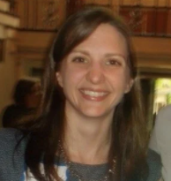
Speaker Introduction
Emily Midgley
Emily Midgley is the President of the Cleveland Chapter of IIBA and has over 15 years of Business Analysis experience in the insurance industry.
She’s led business analysis for programs to implement leading-edge technology, like big data and mobile apps.
As an Agile coach, Emily brings Business Analysis practices to product managers and product owners throughout the enterprise to increase focus on customer value.
Notes:
Tiffani to complete

Slide 3
Poll Questions
Notes:
Size of company
Current role
How far along in Agile Journey

Slide 4
What’s Product Ownership All About?
Product
Product Ownership
Techniques

Slide 5
Why Focus on Products?
Notes:
Increasing rate of change
VUCA
FAANG
Products, not Projects
Product: Something (physical or not) that is created through a process and provides benefit to a market

Slide 6
Product Values
Product | Traditional
Outcome-driven | Deliver requirements
Customer empathy | Manage expectations
Holistic view | Focus on defined scope
Continuous learning & improvement | Adhere to process
From Target Product training
Notes:
Same idea as Agile Manifesto – value the things on the left more.
The things on the right are output focused.
Product orientation values:
outcomes over outputs,
holistic view, not just delivering approved scope
continuous improvement & learning, not just adhering to a process

Slide 7
Product Principles
Product | Traditional
Direct interaction with stakeholders is essential | Communicate with stakeholders through status reports and regular meetings
Organize around experiences / value streams | Organize around funded and prioritized work
Measure deliberately | Measure to variations from plan to reduce risk
Prioritize based on value | Prioritize based on stakeholder requests
Build as little as possible to achieve outcomes | Build what is requested by customers and agreed upon
Assume you are wrong until proven otherwise | Adhere to artifacts and stick to plan
Flexibility is necessary | Build whatever is necessary to complete plan and accomplish the delivery
Experiments are the best way to reduce risk | Manage risk by limiting change and avoiding unknowns
Shared understanding accelerates learning | Define responsibilities and hold each other to those responsibilities
From Target Product training

Slide 8
Characteristics of a Product Team
Fully dedicated
To allow for focus, flow
Skilled, Autonomous
Can address bottlenecks, remove handoffs
In Product, Design, Engineering
Supports top to bottom, beginning to end
Represents the whole value stream
Understand the product, the customers, how it’s supported
Responsible for the whole application stack
Notes:
Standing, cross-functional team(s) support a product throughout its lifecycle (inception, creation, maintenance, sunset).
Teams have all the skills & autonomy to make any changes necessary to the product’s evolution.
Team only works on one product, work doesn’t come from any other source.
Why? Get smaller changes to customers sooner → get feedback → learn → adjust

Slide 9
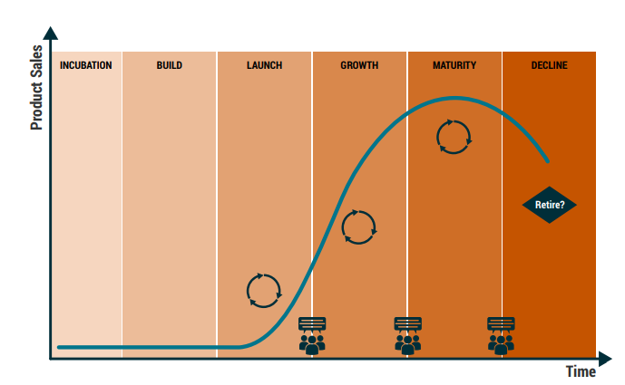
Product Lifecycle

Slide 10
Scrum Team Accountabilities
Developers
Scrum Master
Product Owner
Business Analysts, Proxy POs, or Agile Analysts are here, as a Developer who is skilled in business analysis.
“The Product Owner is accountable for maximizing the value of the product resulting from the work of the Scrum Team. How this is done may vary widely across organizations, Scrum Teams, and individuals.”
- Scrum Guide
ScrumGuides.org by Jeff Sutherland and Ken Schwaber is licensed under CC BY-SA
Notes:
Scrum guide says there are 3 roles. 2020 updates to the Scrum Guide got rid of “Development Team” – it’s all one team now.
They now call the roles “accountabilities”
https://scrumguides.org/scrum-guide.html#scrum-team
“The job title Business Analyst is going away.” – Bob Prentiss

Slide 11
Leave Job Titles Behind
Job titles; a single person responsible
Business Analyst
Product Owner
Roles; skill sets that several people may have
Business analysis
Product ownership
Reduce silos, promote teamwork & collaboration
Notes:
Stop thinking about the job title
Focus on the skills of teammates & outcomes to be delivered.

Slide 12
BA & PO Focus Areas
Business Analysis
Incremental Value
Solutions & Requirements
Scrum Team
both
Product Ownership
Collect & Respond to Feedback
Product Vision & Roadmap
Customers
Solutions & Requirements
Foster Shared Understanding
Attention to Problem Space
Other Internal Stakeholders
Notes:
The WHAT
Business Analysis – Scrum Team, solutions
Product Ownership – other stakeholders, actual customers
Feedback – from Stakeholders, Customers, Team, anybody.
Problem Space – needs, meeting the needs, overcoming the issues. Really solid on the “why” so that they’re not blinded by the “How”

Slide 13
Business Analysis & Product Ownership
Provide Shared Understanding
Provide & Manage Feedback
Answer Questions
Provide Value to Customer
Align to Product Vision
Discover Needs
Evaluate Solution
Slice into small batches
Prioritize
Elaborate
Make Decisions
Notes:
The HOW
Explain the flow from align, discover, then provide shared understanding to the scrum team, and make decisions, get the product increment to customers, then come back to Evaluate Solution – something that’s often not done.
Yes, both provide shared understanding to different audiences.
Super important for BA because tech team can get lost in implementation.

Slide 14
BA & PO Techniques
Slicing / Splitting
User Story Mapping*
Story Decomposition
Minimum Viable Product*
Strategy
Backlog Refinement
Behavior Driven Development
User Stories
Job Stories*
Visioning*
Product Roadmap*
Impact mapping
*Technique is described in both Agile Extension to BABOK® Guide and IIBA’s Guide to Product Ownership Analysis

Slide 15
More BA & PO Techniques
Provide Shared Understanding
Provide & Manage Feedback
Answer Questions
Provide Value to Customer
Align to Product Vision
Discover Needs
Evaluate Solution
Slice into small batches
Prioritize
Elaborate
Make Decisions
Backlog Refinement
Planning Workshop
Story Mapping
Product Roadmap
Visioning
Business Model Canvas
MVP
Story Mapping
Story Decomposition
Planning Workshop
Story Mapping
Collaborative Games
Retrospectives
Reviews
Stakeholder Mgt
Personas
Value Modeling
General Elicitation
Story Elaboration
Job Stories
User Stories
Acceptance Criteria
Behavior Driven Development
General Collaboration
General Elicitation
Acceptance Criteria
Impact Mapping
Metrics & KPIs
Notes:
All of these techniques appear in the BABOK, Agile Extension, or Guide to PO
Not an exhaustive list
“General” means there are lots of techniques that help this
Impact Map – with Solution Evaluation

Slide 16
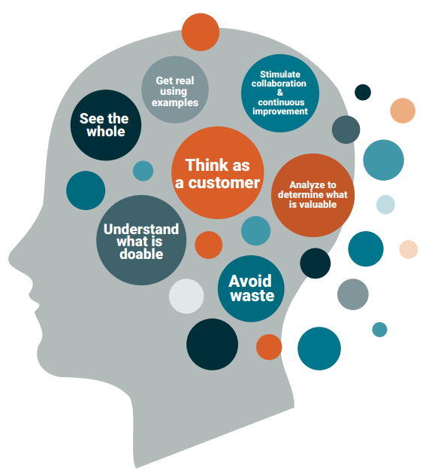
7 Principles of Agile Business Analysis
Notes:
7 Principles are in the Agile Extension
This image from POA guide

Slide 17
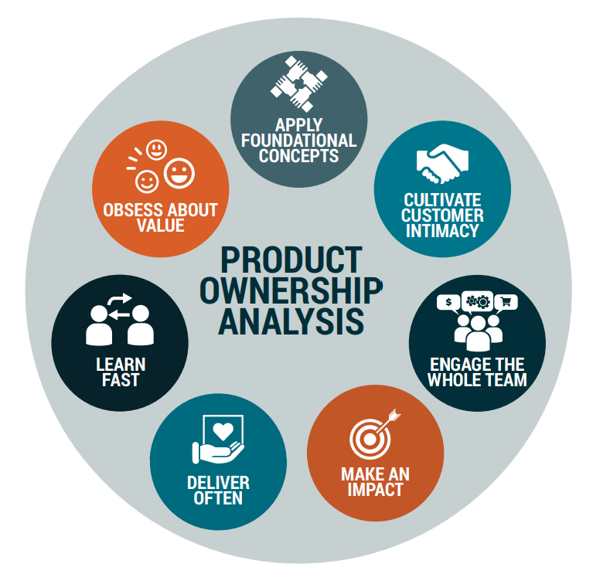
Product Ownership Analysis Framework
Notes:
Tips and Resources for POA

Slide 18
Q&A

Slide 19
Interested in Product Ownership?
Uncover the framework, context, techniques, and competencies that can give you an advantage.
Guide to Product Ownership Analysis
50+ case studies
25+ techniques
IIBA.org/POA

Slide 20
IIBA.org/POA

