Slide 1
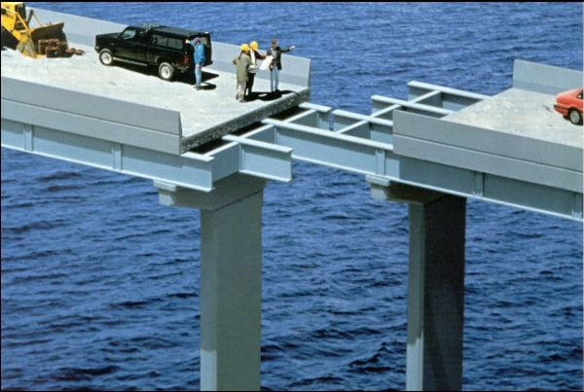
Craftsmanship
for Analysts
Terry Wiegmann, CSQE CBAP PSPO ACG
terry@thewiegmanngroup.com

Slide 2
Path to Agility 2012

Slide 3
3,470,000 Results!

Slide 4
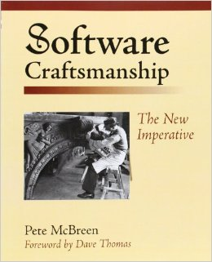
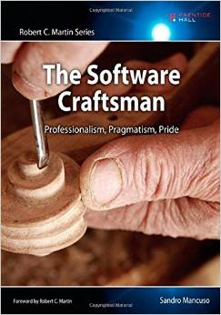
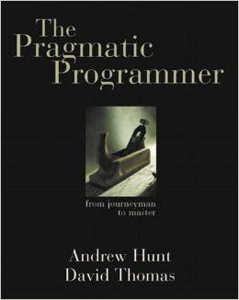
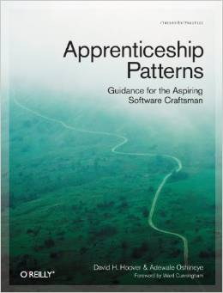

Slide 5
Manifesto for Software Craftsmanship
As aspiring Software Craftsmen we are raising the bar of professional software development by practicing it and helping others learn the craft.
Through this work we have come to value:
Not only working software
but also well-crafted software
Not only responding to change
but also steadily adding value
Not only individuals and interactions
but also a community of professionals
Not only customer collaboration
but also productive partnerships
That is, in pursuit of the items on the left we have found the items on the right to be indispensable.

Slide 6
My Story

Slide 7
What is Craftsmanship?
Workmanship
Handiwork
Artistry
Art
Craft
Artisanship
Skillfulness
Work
Technique
Skill
Mastery
Expertise

Slide 8
Once Seen, You Can’t Unsee!

Slide 9
Characteristics of Craftsmanship
Motivated by mastery rather than attaining a status
Willing to make sacrifices in finances, free time & relationships
Believe in the end-value of what they are making
Balance passion for history & tradition w/drive to innovate
Plan and think things through first
Immerse themselves and can maintain focus on their work
Put in the hours for their craft to become a habit of daily life.
Know that you’ve never really “made it”.
Notes:
http://www.neboagency.com/blog/characteristics-craftsmanship/

Slide 10
PSP May 1996/TSP 2000
Provides software engineers with disciplined methods for improving personal software development processes.
Improve their estimating and planning skills.
Make commitments they can keep.
Manage the quality of their projects.
Reduce the number of defects in their work.
Notes:
Personal Quality Management with the Personal Software Process
http://www.methodsandtools.com/archive/archive.php?id=60

Slide 11
Values from Apprenticeship Patterns: Guidance for the Aspiring Software Craftsman
Effort is what makes you smart or talented
Adapt and change based on feedback
Pragmatic rather than dogmatic
Share rather than hoard what we know
Willingness to experiment
Internal locus of control
Situational learning
Notes:
Apprenticeship Patterns: Guidance for the Aspiring Software Craftsman
By Dave Hoover, Adewale Oshineye

Slide 12
Two Sides of Same Coin?
Craftsmanship
Skill at making things, or the skill with which something was made
Competence
The ability to do something well or efficiently; possession of required skill, knowledge, qualification, or capacity

Slide 13
IIBA Competency Model
Expert
53 Performance Competencies
20 Underlying Competencies
Dreyfus Model of Skills Acquisition
Proficient
Competent
Advanced Beginner
Novice

Slide 14
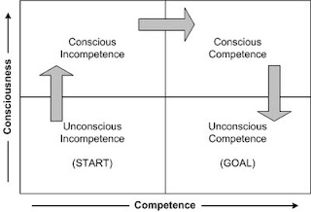
4 Stages of Learning Any New Skill
Notes:
Initially known as the “four stages for learning any new skill,” the 4 States of competence was a learning model originally introduced by Noel Burch, an employee of Gordon Training International. First drafted in the 1970s, this “conscious competence” learning model is described as the psychological states that are involved in transforming skill incompetence to competence or outright mastery.

Slide 15
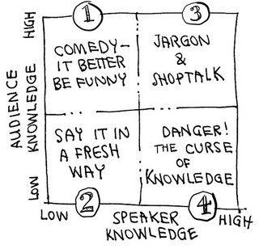
Curse of Knowledge

Slide 16
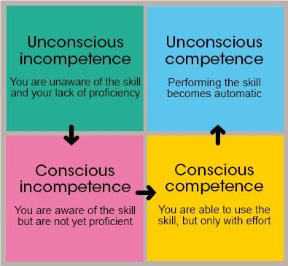
Four Stages of Learning New Skill
Notes:
Initially described as “Four Stages for Learning Any New Skill”, the theory was developed at the Gordon Training International by its employee Noel Burch in the 1970s.^{[1]} It has since been frequently attributed to Abraham Maslow, although the model does not appear in his major works.^{[2]}

Slide 17
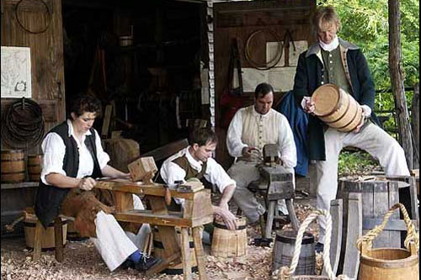
Apprentice Journeyman Master

Slide 18
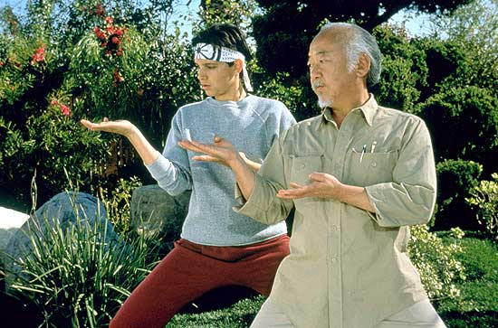
Ri
Ha
Shu

Slide 19
Developmental Levels Maureen Metcalf
Diplomat
Expert
Achiever
Individualist
Strategist
Alchemist
Notes:
http://www.metcalf-associates.com/wp-content/uploads/2010/10/Developmental-Basics_the-Jill-Story-final-v2.pdf

Slide 20
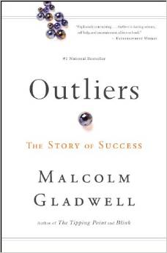
10,000 Hours
Why do some people succeed,
living remarkably productive and impactful lives,
while so many more
never reach
their potential?

Slide 21
QWAN

Slide 22
Flip Side/Craftsmanship Backlash
Displaced programmers’ response to agile practices.
Software Craftsmanship risks putting the software at the centre rather than the benefit the software is supposed to deliver, mostly because we are romantics with big egos.
Success is about getting information from point A where it’s currently languishing to point B where it’s going to actually be useful, as quickly and effectively as they can.
Liz Keogh: failing to look at the background of the movement, and jumping on a bandwagon which lets them concentrate on the things they find stimulating while ignoring the bigger picture.
Notes:
http://dannorth.net/2011/01/11/programming-is-not-a-craft/

Slide 23
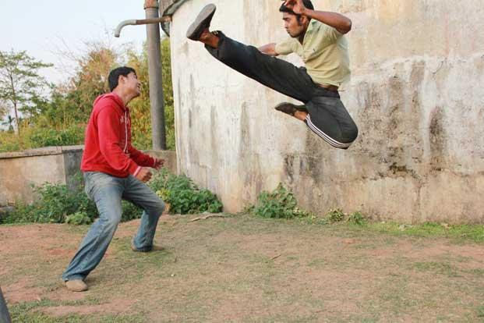
Analysis Fu

Slide 24
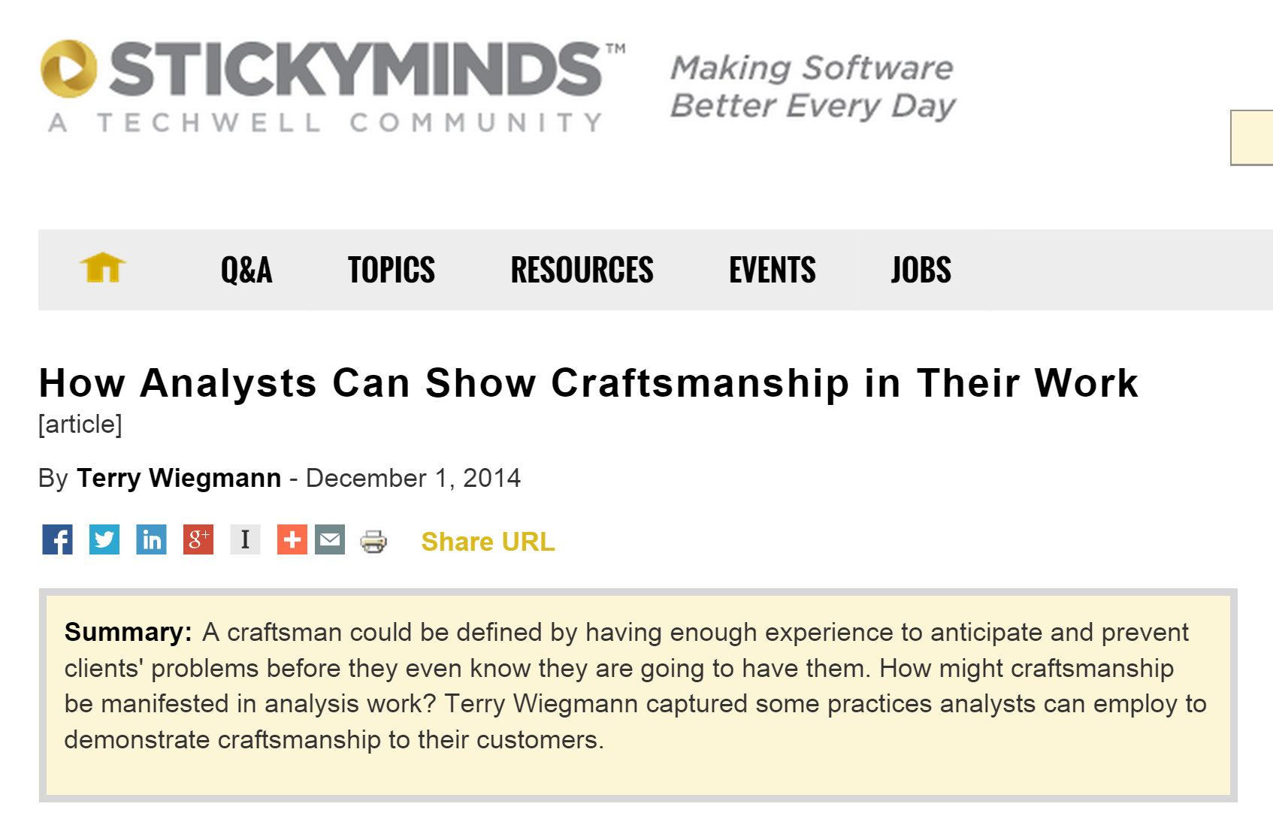
Notes:
Not happy with title

Slide 25
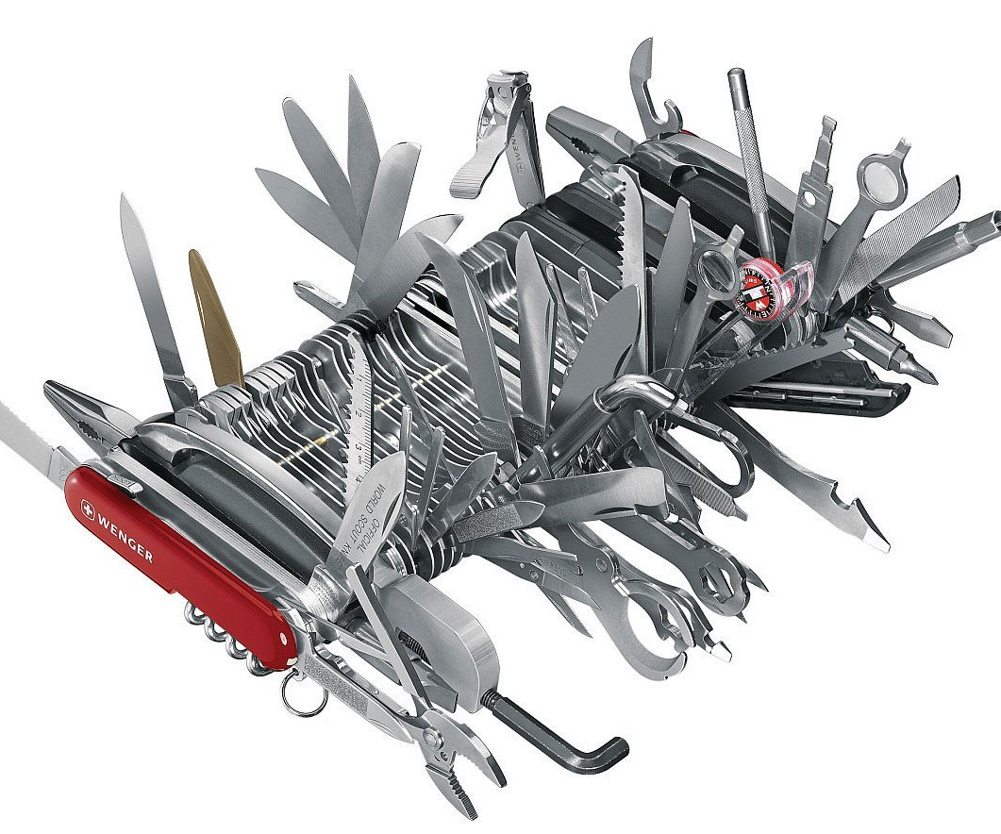
Know Your Tools
Styles
Headings
Spikes
Word Count
Notes:
A Good Craftsman Knows His Tools
http://accu.org/index.php/journals/1557

Slide 26
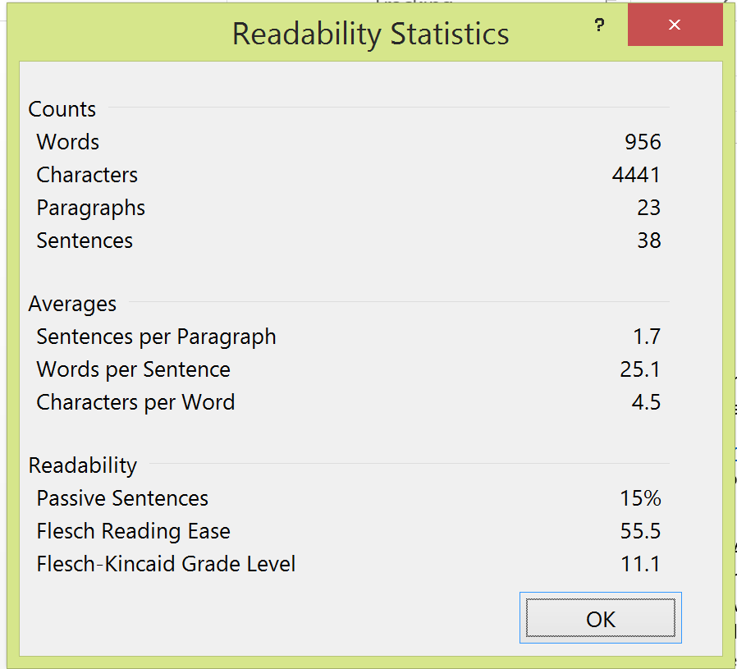
Readability Statistics
Reading Ease
100-point scale. The higher the score, the easier to understand. Aim for between 60 and 70.
Flesch-Kincaid Grade Level test
Rates text on a U.S. school grade level; e.g., a score of 8.0 means that an eighth grader can understand the document.

Slide 27
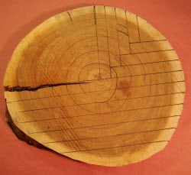
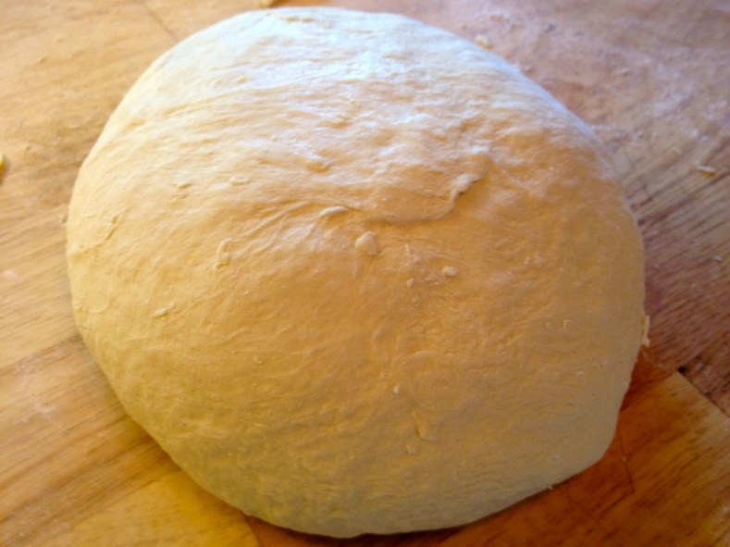
Know Your Materials Properties & Conditions
Notes:
Humidity, altitude

Slide 28
Matching Stripes and Plaids

Slide 29
Know What’s Going On
Notes:
Techniques, materials, tools, domains, regulations

Slide 30
Why?
What’s in Your Portfolio?

Slide 31
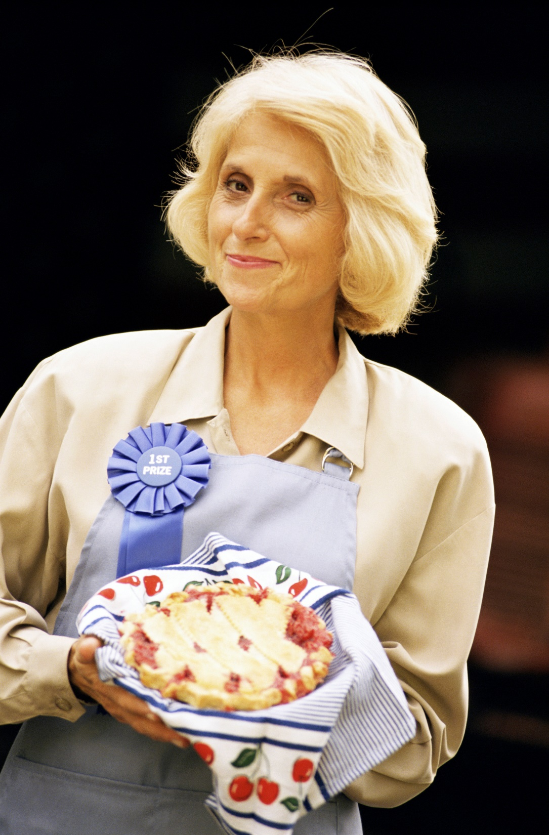
What if
you had
a Contest?

Slide 32
Define acronyms at
the beginning of
the document

Slide 33
Date/Version
Not Sharepoint
Comparing Hard Copies

Slide 34
Using Color
Sequence
Mnemonic
Readability
Aesthetic

Slide 35
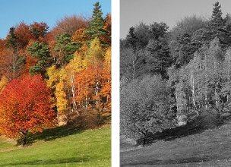
Colors, Black & White or Green?

Slide 36
Format for printing
Notes:
Why move burden to everyone else?

Slide 37
Format for Discussion/ Review Line Numbers

Slide 39
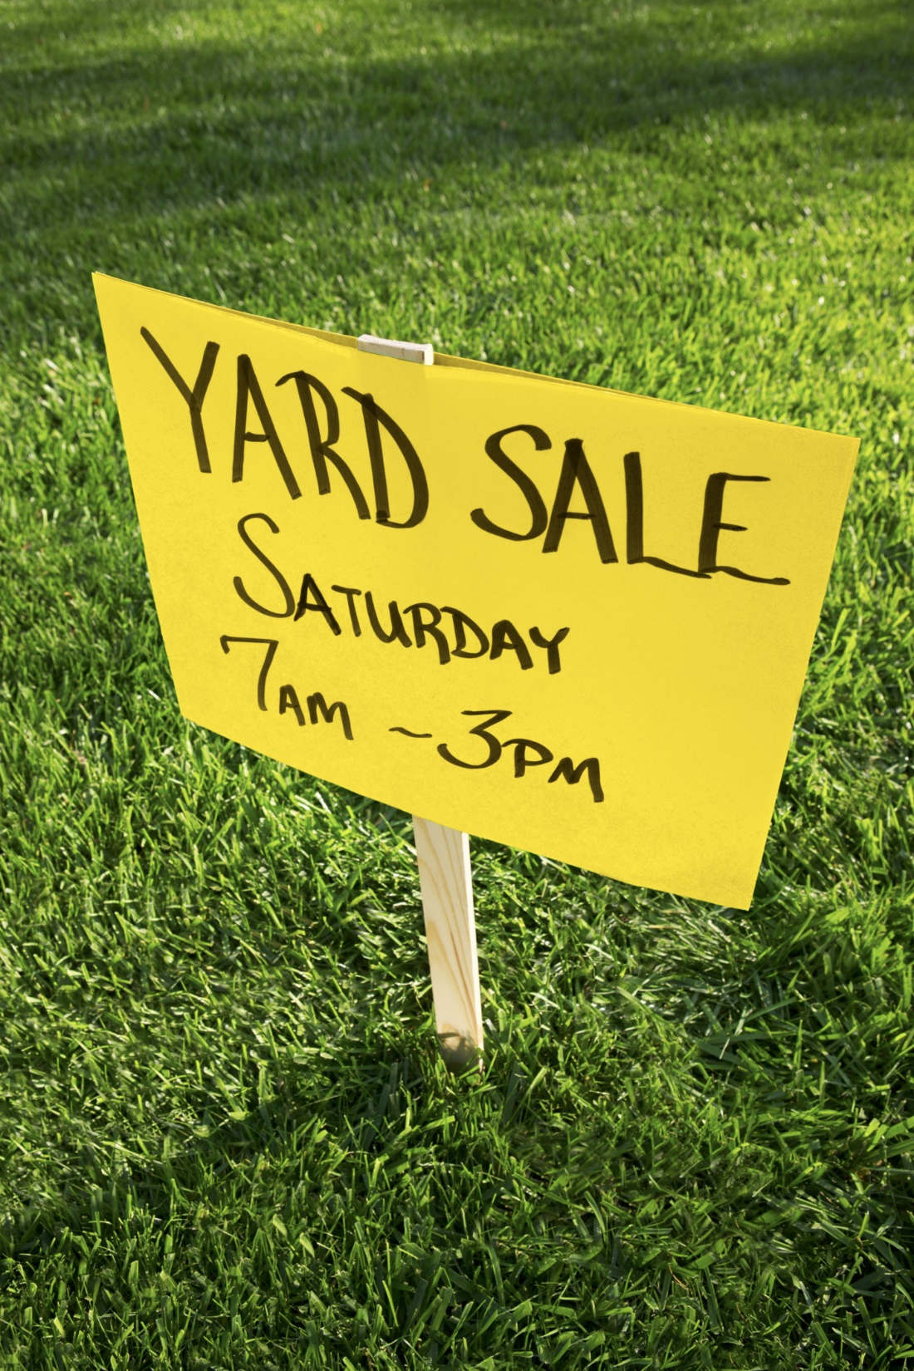
Big Visible Heuristic
Answer 3 Questions
In 3 Seconds
From 3 Yards Away

Slide 40
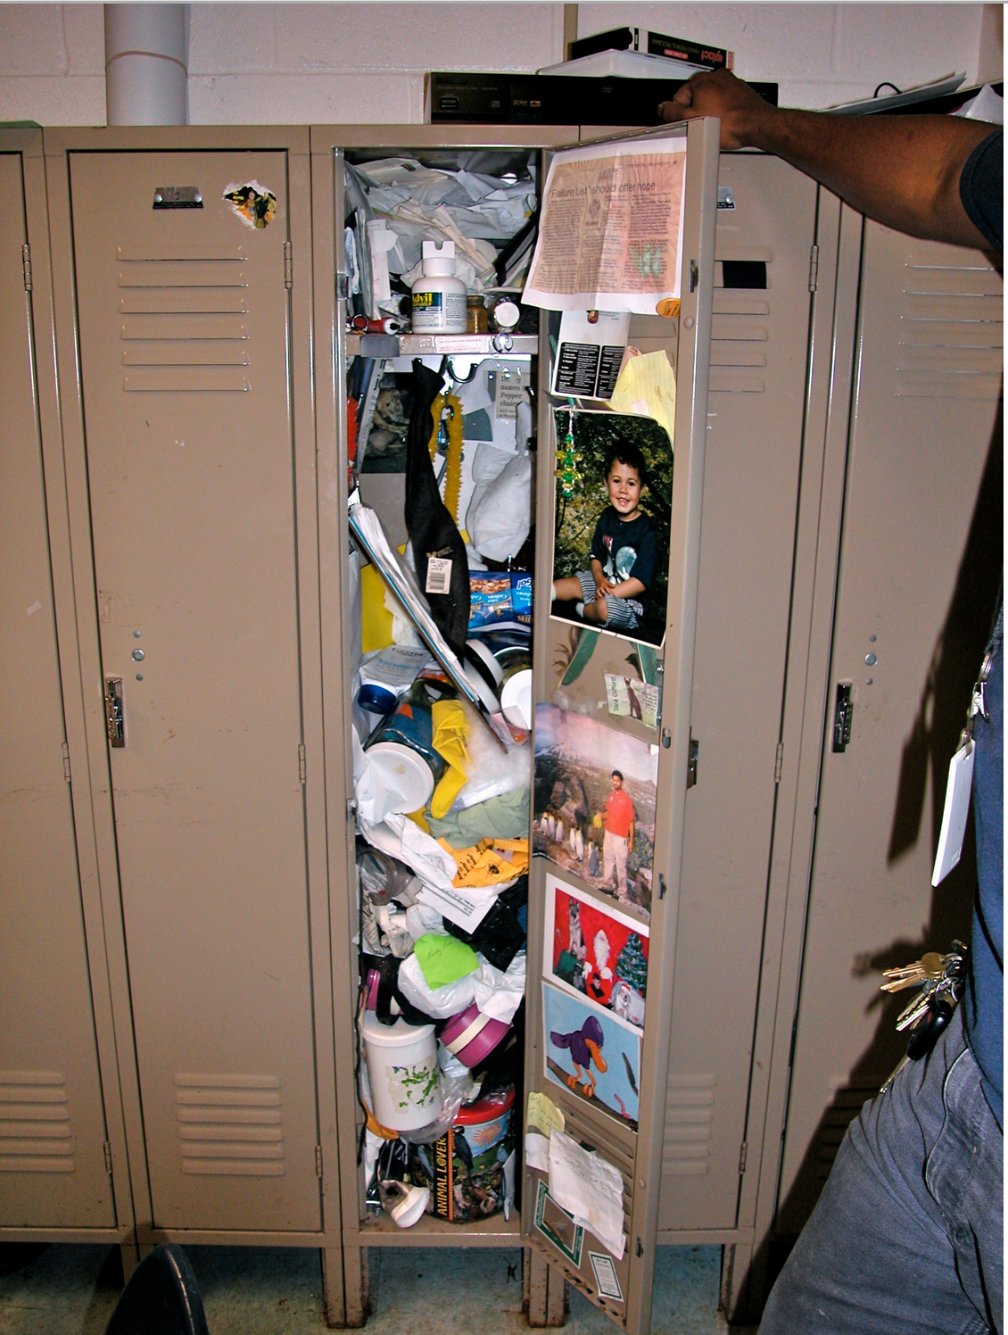
Give Your Page Room to Breathe
Notes:
Number of pages vs readability

Slide 41
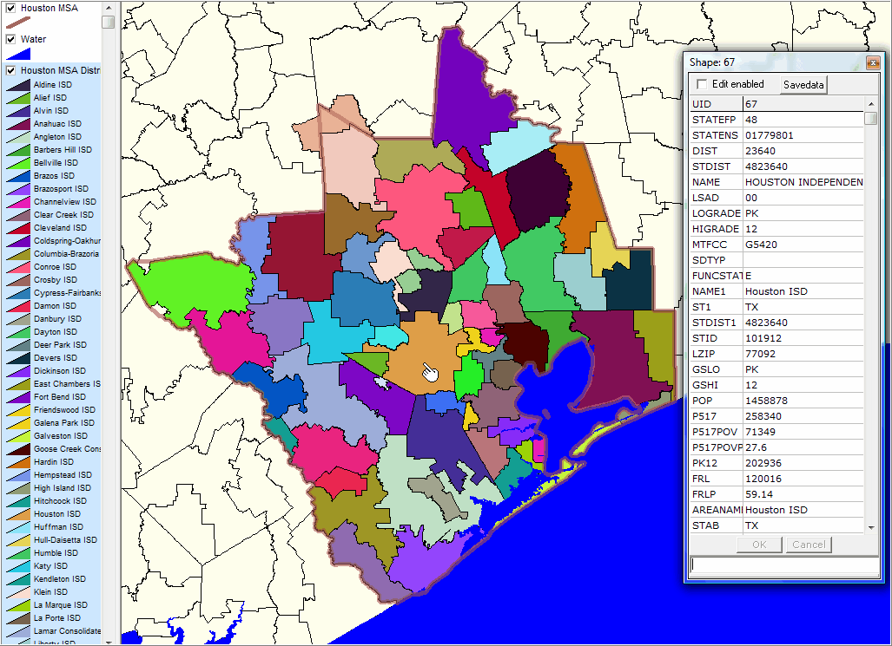
Legends
Are they needed?
Useful/usable?
If there is no meaning, say so
Notes:
Project, go to back of room

Slide 42
Usage Scenarios
Orient the user, then explain
Index scavenger hunt
Make it easy for readers to use references
Usage context: page size, light, temperature, lamination, field size
What will users look for? (Check One, old names?)

Slide 43
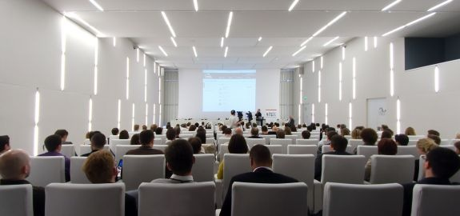
Test it!
Notes:
Word Counts

Slide 44
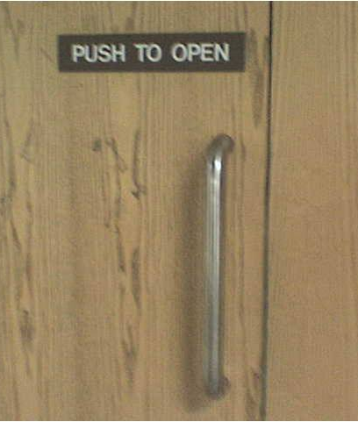
Affordance
Do people know what to do based on what they see?
"If you have to add verbal instructions, you designed it wrong“ – Donald Norman, The Design of Everyday Things
Notes:
https://www.quora.com/What-are-examples-of-affordances

Slide 45
Does X Mean Yes or No?

Slide 46
Tab and Sheet Labels

Slide 47
Underlining

Slide 48
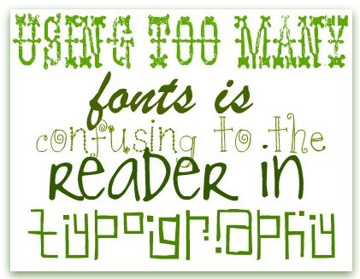

Slide 49
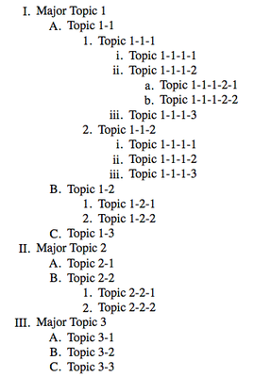
Roman Numerals

Slide 50
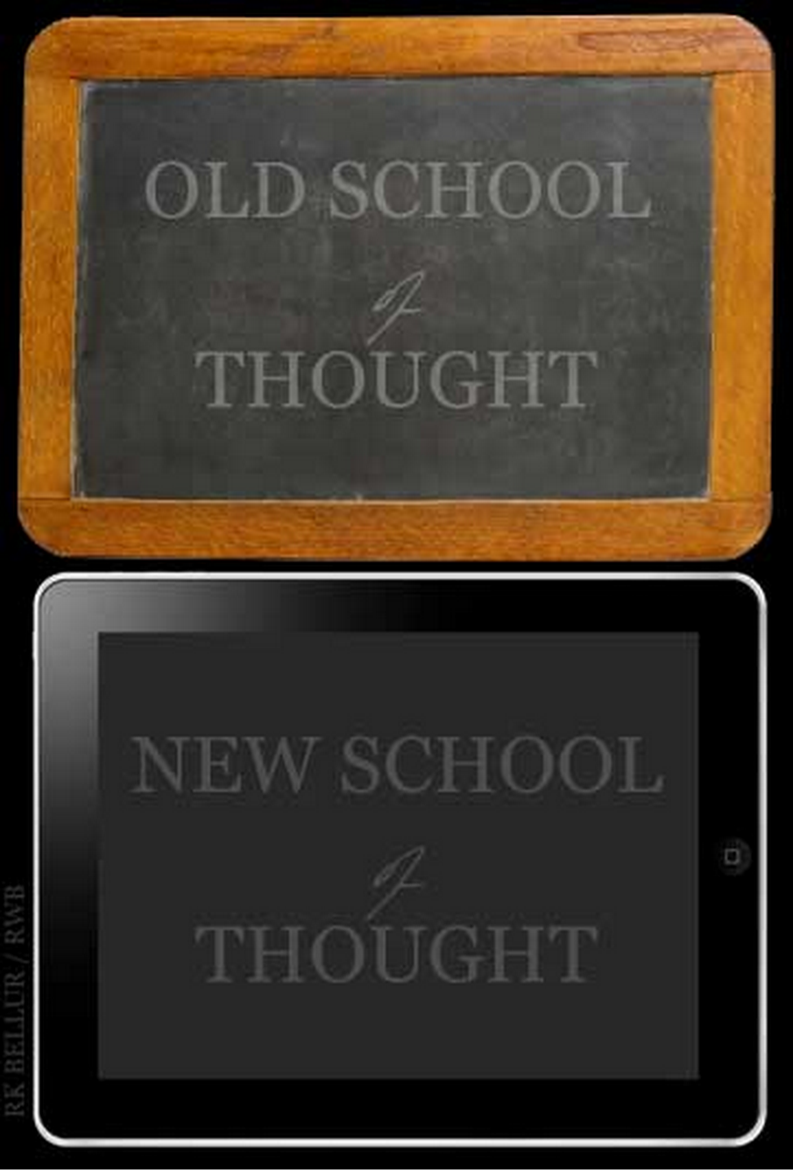
Tense
Given: Past Tense
When & Then: Present Tense

Slide 51
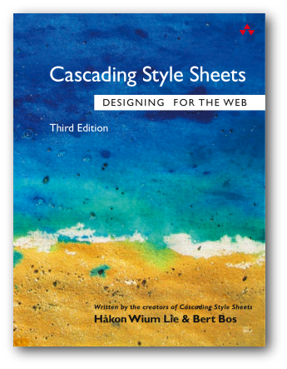
Style Guide
Reserved Words
Choose or Select
Click or Press
Sees/is Displayed

Slide 52
Punctuation Saves Lives
Let’s eat Grandma!
Let’s eat, Grandma!
A woman without a man is nothing
A woman, without a man, is nothing
A woman: without, a man is nothing

Slide 53
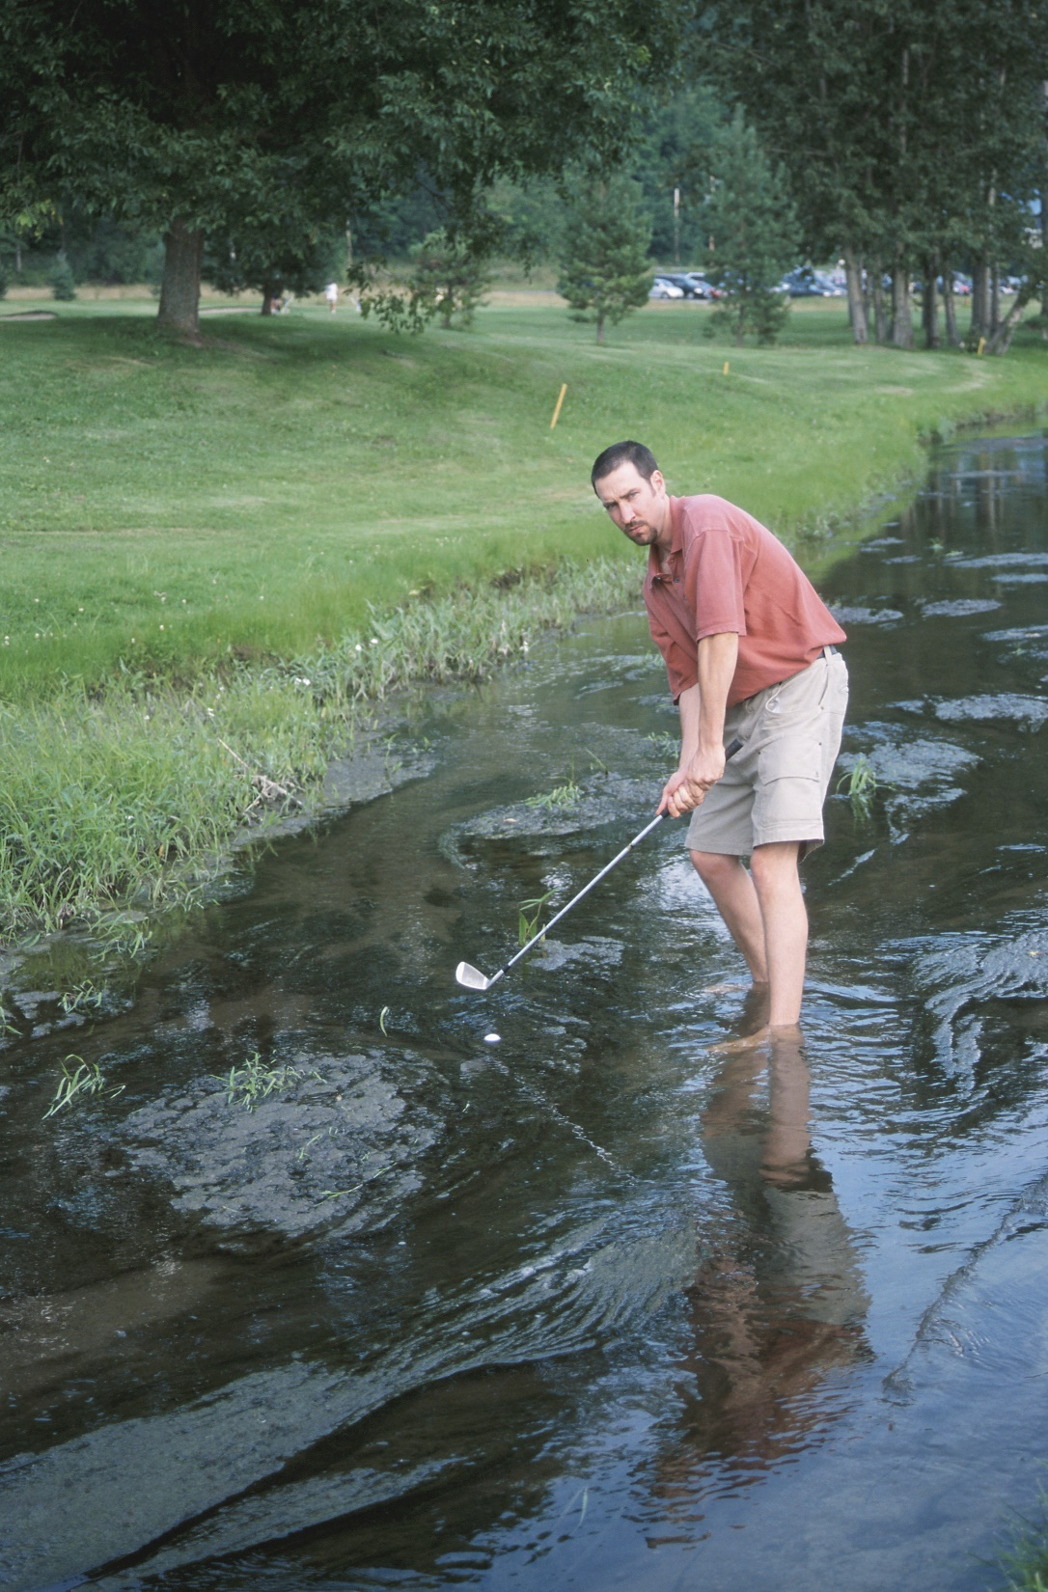
Contranyms & Interpretations
Bogey
Table Stakes
Throw Out
Fix
Table
Custom
Date format
Dollars
Notes:
Fix the Date

Slide 54
Picky about Pronouns
After sending a break-up text message to his girlfriend Skyler, Jesse forgot to wash his hands before he mixed old mayonnaise into the potato salad with a dirty spoon. That was disgusting!
Edwin told Kenny that Dr. Wilson suspected that he cheated on the chemistry exam.
Lightning struck the roof, frying the circuit breaker and shorting out the television and computer. Mom can't afford it this month.
I never ride roller coasters because they make you throw up.

Slide 55
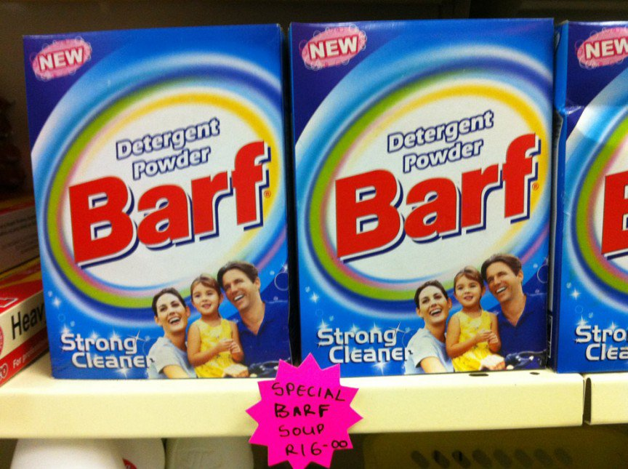
Prepare for I18n and L10n
Contractions
Error messages
Notes:
Barf in Farsi, Hindi, and Urdu means snow.

Slide 56
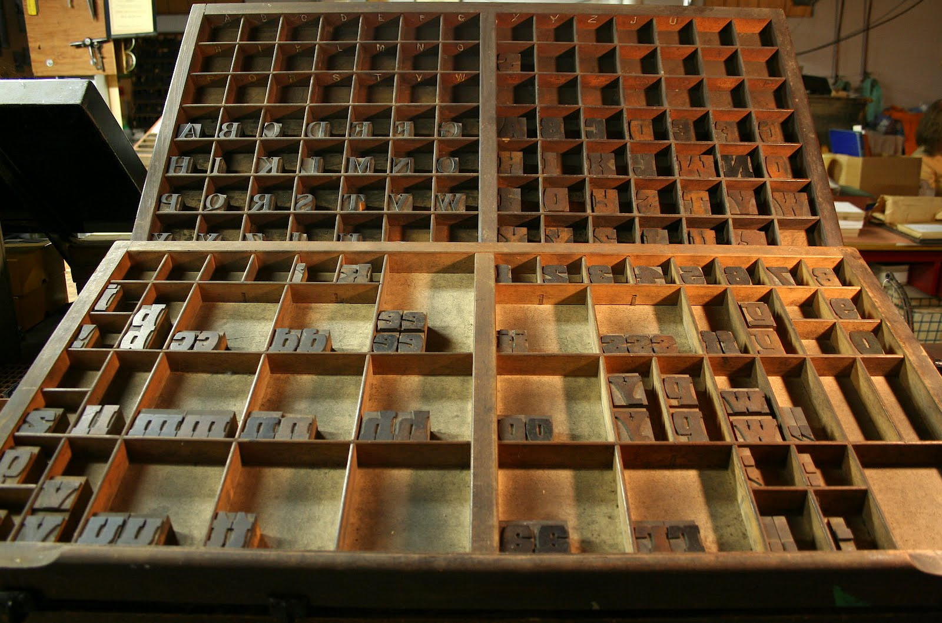
Capitalization
Titles
Headings
Bullets

Slide 57
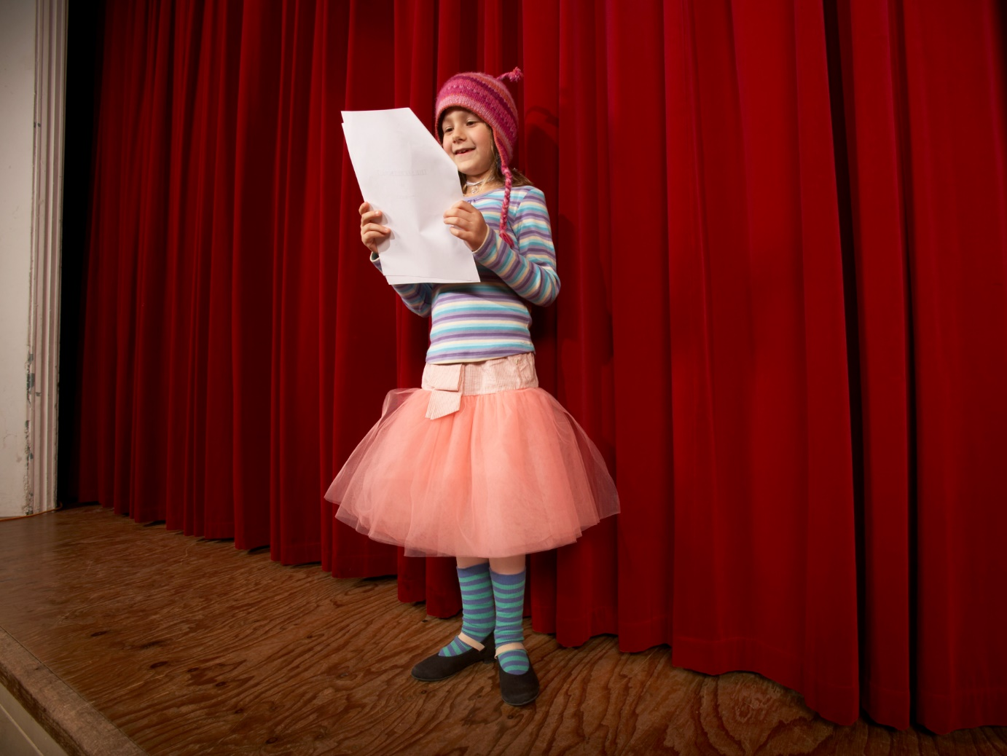
Read it aloud!
Notes:
Divine, Maude, misheard lyrics

Slide 58
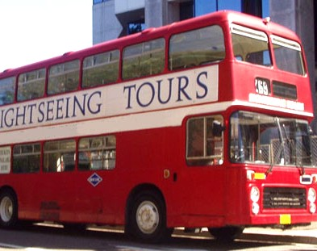
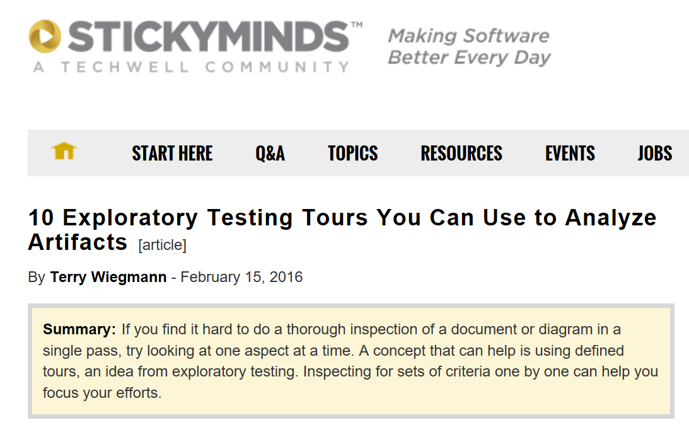

Slide 59
