Slide 2

Agenda:
How to Write Excellent Requirements
Why are Excellent Requirements Important?
What are Excellent Requirements?
Where are Excellent Requirements Found?
Who is to Write the Excellent Requirements?
When are Excellent Requirements to
be Written?
How are Excellent Requirements Written?
Notes:
Being an analyst, I approached the presentation by documenting who, what, when, where, why and how around Excellent Requirements.

Slide 3

Why are Excellent Requirements Important?
Understand the goals and end result the stakeholders pursue
Ensure stakeholders get what they truly need
Reduce misunderstandings
Allow a team to respond to change
Notes:
Documenting excellent requirements will get the team to what the stakeholders truly need and value!!
Excellent requirements must be communicated and documented so that it is clear what exists to determine what needs to be changed.

Slide 4
What are Excellent Requirements?
Excellent Requirements have the following characteristics:
Valuable
Concise
Design Free
Attainable
Complete
Consistent
Unambiguous
Verifiable
Atomic
Understandable
Notes:
Taken from the Excellent Requirements Checklist provided by B2T.

Slide 5

Valuable – Right Features & Capabilities
Make progress toward satisfying
the needs of your stakeholders
Support your business strategy
Provide value to the
stakeholders
Notes:
When we spoke of 12 Mean and Lean Analysis Approaches for Agile Teams, we stressed delivering high value items sooner.

Slide 6
Concise – Useful, Easy to Read & Change
Identify the needs of
the stakeholder
(include opportunities,
problems and risks)
Explain why the needs
are worth satisfying
(meet objectives)
Define when those needs are satisfied

Slide 7
Design Free
Should NOT specify implementation (How)
Should specify What
  What information is needed
  What processes are needed
  What business rules need to be applied
Leave options for the delivery team to figure out how
BUT is the requirement technically feasible?

Slide 8
Is this an excellent requirement?
The system shall work just like the previous one, but on a new platform.
If you feel it isn’t, how can it be improved?
Notes:
Translation: Don’t implement features we no longer use.
Features in the old platform may not work on the new platform.

Slide 9
Attainable – Can Be Met
Describe a solution that is ATTAINABLE and is in conjunction with VALUABLE requirements
COST should not be more than BENEFIT received by requirement

Slide 10
Is this an excellent requirement?
The response time of the system must be less than 2 seconds.
If you feel it isn’t, how can it be improved?
Notes:
Under which condition are you expecting a 2 second response time?
Consider natural variances, particular functionality,

Slide 11
Is this an excellent requirement?
The system must provide round-the-clock availability.
If you feel it isn’t, how can it be improved?
Notes:
Translates to 24 hours, 7 days a week, 365 days per year. How much will it cost? When will backups occur? When will maintenance be done?

Slide 12

Complete – Not Missing Anything of Value
Identify ALL of the stakeholders’
needs
Ensure requirements are logically
complete in their coverage of the
stakeholder needs
Ensure requirements are logically
complete in their articulation of
the stakeholder needs
Notes:
Have all assumptions been explicitly stated?
Are requirements stated as completed as possible?
Are requirements missing? Use the Context DFD to identify missing requirements….

Slide 13
Complete – Not Missing Anything of Value (continued)
Find missing requirements by building a Context Level DFD
External Agent
(Customer)
Dataflow
(Order)
External Agent
(Store Location System)
Project
(Ordering Mobile Application)
Interface
External Agent
(Card Credit Processor)
External Agent
(Cashier)
Project Boundary

Slide 14
Complete – Not Missing Anything of Value (continued)
Functional
Performance
Interface
Environment
Facility
Transportation
Training
Personnel
Operability
Safety
Security
Appearance and Physical Characteristics

Slide 15
Consistent – Similar Look & Feel
Requirements should be grammatically consistent to reduce the chance of ambiguity
Requirements should be logically consistent so that “impossible” requirements are avoided and there are no gaps of unspecified meaning
Requirements should be consistent with business goals and organization’s vision
Ensure terminology is consistent with user’s terminology and consistent throughout the document (glossary)
Consistent with other requirements – rather than in conflict
Notes:
Screens and reports should have a consistent “look and feel” – DEFINE STANDARDS!!

Slide 16
Poll #1
Do you use a template when writing requirements to keep a consistent “look and feel” in your organization?
ANSWER “YES” OR “NO”

Slide 17

Unambiguous – On the Same Page
Requirements should have a single, reasonable interpretation
Avoid inserting ambiguity
into requirements:
  As appropriate
  But not limited to
  To be able to
  Is capable of
  Approximate
  Etc.

Slide 18
Is this an excellent requirement?
The system must provide reporting.
If you feel it isn’t, how can it be improved?
Notes:
Must be specific about the reports that are needed in support of the business.

Slide 19
Is this an excellent requirement?
The system must be easy to use.
If you feel it isn’t, how can it be improved?
Notes:
Ask the users what makes the software easy to use?
Is it necessary to have training for end-users to master the finished product?

Slide 20
Verifiable – Testable
Need to determine whether the requirements are successfully met
Can the requirements be tested?
Requirements identified in scope or requirements gathering (user story/use case building) are traced to design to code and finally to test
Test
Requirements
Design
Code

Slide 21
Verifiable – Testable (continued)
Free of unverifiable terms:
sufficient
easy
flexible
User friendly
fast
large
adequate
safe
robust
small
versatile

Slide 22
Is this an excellent requirement?
The system must have good usability.
If you feel it isn’t, how can it be improved?
Notes:
To WHOM does it have to “feel good” to? List the users of the system and their requirements.
A better requirement: A customer service representative should be able to enter three issues in less than 15 minutes.

Slide 23
Is this an excellent requirement?
The system must be bug-free.
If you feel it isn’t, how can it be improved?
Notes:
Need to know the responsibilities of all the participants in the project.
Identification of
change management
quality assurance
help system
documentation,
end-user training.

Slide 24
Atomic
The requirement (user story/use case) represents a single stakeholder need that is satisfied or not
Express only one thought per requirement statement
A requirement needed to meet the parent requirement
A requirement traceable to a parent requirement?
A requirement which is allocation to the next lower level documented

Slide 25
Is this an excellent requirement?
The system must be accessible.
If you feel it isn’t, how can it be improved?
Notes:
Can be wide or restricted
List of each user and what feature/function they should have access to.

Slide 26
Understandable
The requirement should be written to be understood in only one way
Use consistent terminology
Free of typos, misspellings and punctuation errors
Compliant with the template and style rules (including page numbers)

Slide 27
Where are Excellent Requirements found?
In Stakeholders’ Heads
In Existing Reports
In Existing Screen
In Existing Code
In Vendor Documentation
In Competing Products
In Problems from Prior Iterations
In Our Existing Documentation
In Procedures
In Manuals
In Developers’ Heads
In Testers’ Heads
In Vendors’ Heads

Slide 28
DISCUSSION QUESTION:
If you are working in an Agile Environment, how do you document excellent requirements?

Slide 29

Who is to Write Excellent Requirements?
Stakeholders are responsible for specifying excellent requirements.
Business Analysts are responsible for eliciting and refining excellent requirements.
Project Managers, Testers and Developers should be involved in the requirements process.

Slide 30
When are Excellent Requirements Written?
Start in Scope (Context Level DFD)
…and are written through Design
(Functional/Non-Functional Requirements)

Slide 31
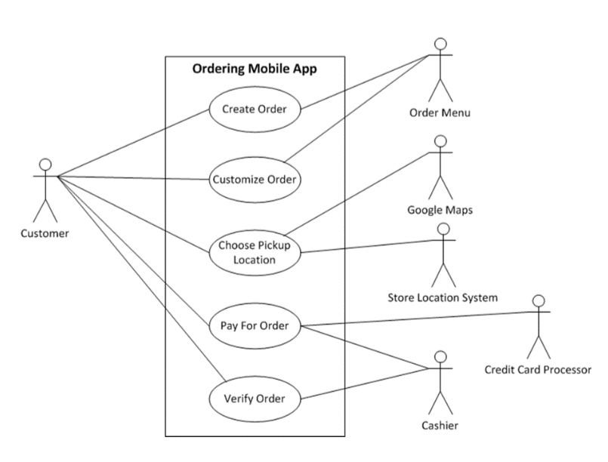
How are Excellent Requirements Written?
WORDS
The airline shall be able to change the aircraft’s seating from business to holidays charter use in less than 12 hours.
The navigator shall be able to view storm clouds by radar during the flight and 15 minutes prior to the flight using the navigation software.
PICTURE
OR

Slide 32
How are Excellent Requirements Written?
External Agent
(Customer)
Dataflow
(Order)
External Agent
(Store Location System)
Project
(Ordering Mobile Application)
Interface
External Agent
(Card Credit Processor)
External Agent
(Cashier)
Project Boundary

Slide 33
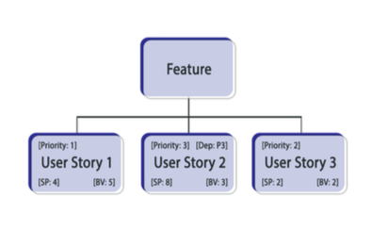
How are Excellent Requirements Written?

Slide 34
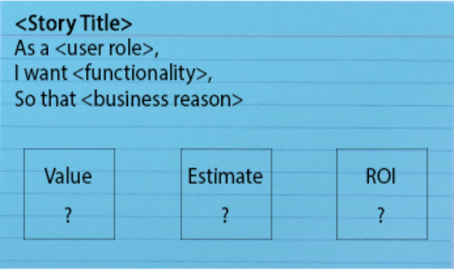
How are Excellent Requirements Written?

Slide 35

Remember…
Requirements need to be:
  Valuable
  Concise
  Design Free
  Attainable
  Complete
  Consistent
  Unambiguous
  Verifiable
  Atomic
  Understandable

Slide 36




Stay in Touch
 | pamswent@gmail.com
 | @SwentPam
 | linkedin.com/in/pamswent
 | Like us on Facebook
Notes:
Closing Slide

